Slide 1


Faculty of Physics, University of Vienna &
Institute for Quantum Optics and Quantum Information – Vienna
The covariance of physical laws in quantum reference frames
Flaminia Giacomini, Esteban Castro, Časlav Brukner
Nature Communications 10, 494 (2019),
Phys. Rev. Lett. 123, 090404 (2019)
Seminar at the Particle Physics Group, Vienna, March 10th, 2020

Slide 2
Outline
Covariance of physical laws
Quantum reference frame
“Superpositions of spatial translations”
“Superpositions of Galilean boosts”
“Superposition of accelerations”
“The rest frame” of a quantum particle
*Relativistic Spin Qubit
Conclusions

Slide 3

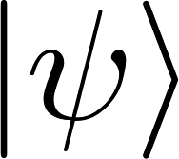

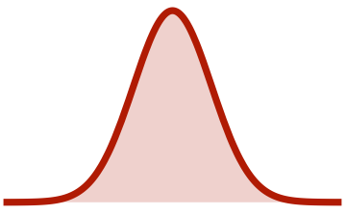
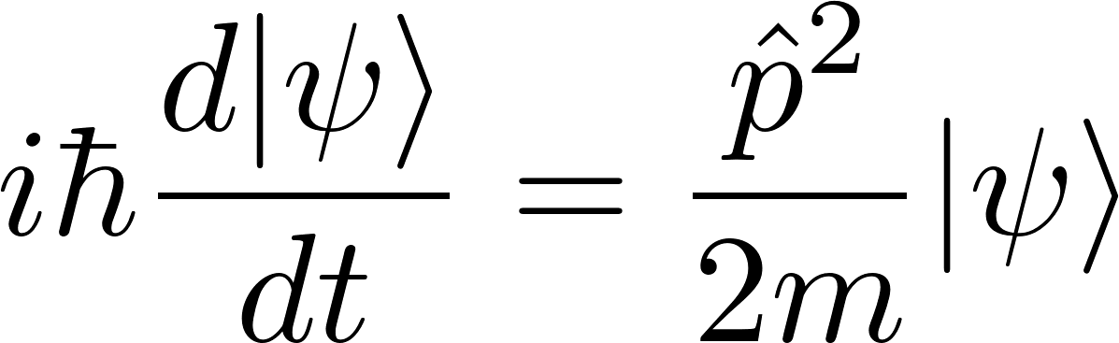
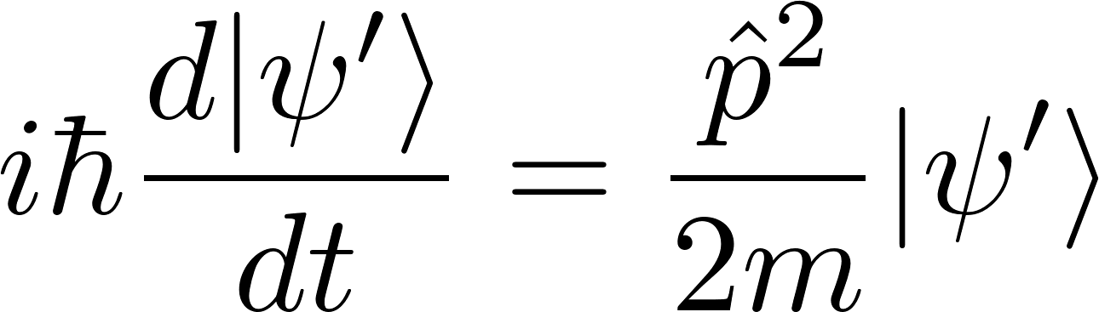
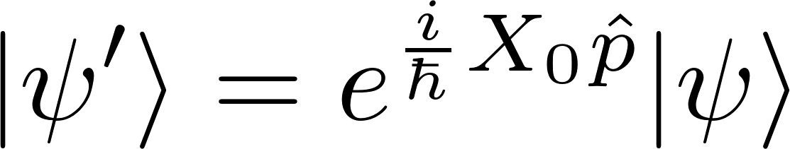
Covariance of physical laws
The laws of physics are of “the same form” regardless of the choice of the reference frame.
Translations
RF
RF’
where

Slide 4

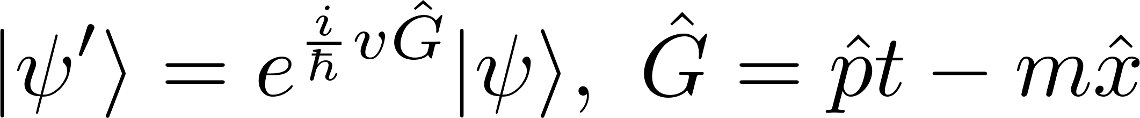
Covariance of physical laws
The laws of physics are of “the same form” regardless of the choice of the reference frame.
Boosts
RF
RF’
where

Slide 5
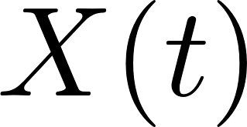
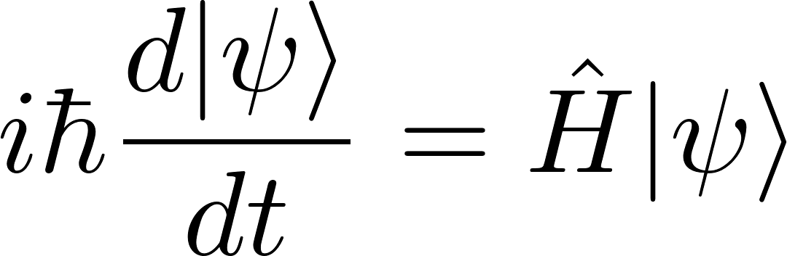
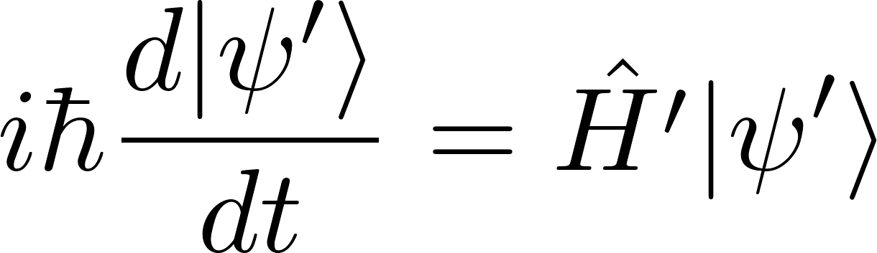
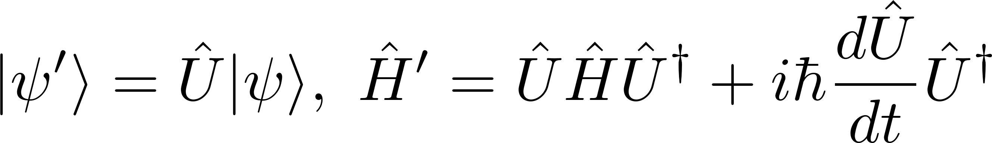
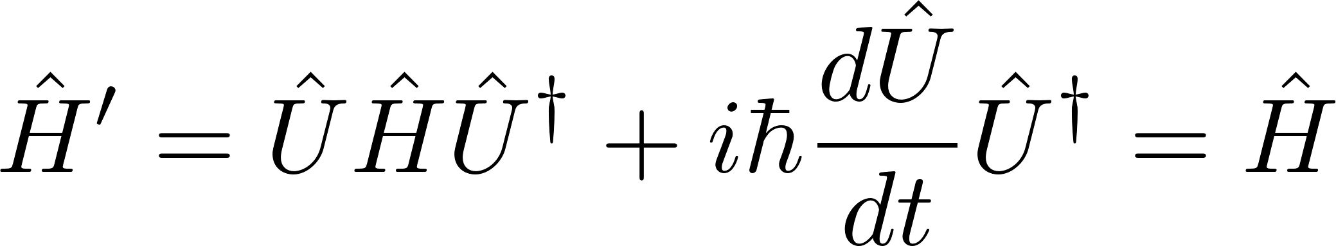
Covariance of physical laws
The laws of physics are of “the same form” regardless of the choice of the reference frame.
General Transformation
RF
RF’
where
A transformation is a symmetry if:

Slide 6
Real reference frames
In practice, RFs are physical systems.
10m
A
B
C
Statement from RF A: “The system B is 10 m away from the tree”.

Slide 7
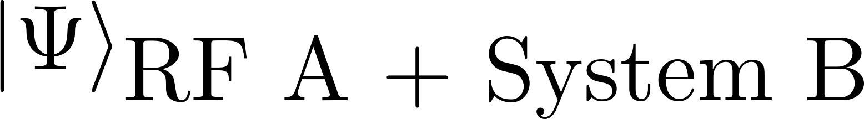
Real reference frames
In practice, RFs are physical systems.
They ultimately obey quantum mechanical laws.
A
B
Quantum state as seen from RF C
Are physical laws covariant under the change of quantum RFs? How to formalize this idea?

Slide 8
Intuitive picture
The view from the lab frame:
A particle in a superposition in a Mach-Zehnder interferometer
The view from the particle’s frame: The Mach-Zehnder interferometer in a superposition
*Taken from: R. Angelo, N. Brunner, S. Popescu. A. J. Short, P. Skrzypczyk, J. Phys. A: Math. Theor. 44 (2011) 145304

Slide 9
“Absolute positions”
“Background”

Slide 10
“Relative positions”

Slide 11
“Relative positions”

Slide 12
Relative quantities
“New QRF”
A
The description of the quantum state is given in terms of relative quantities.
From C: Systems are A and B
From A: Systems are C and B
B
“System”
C
“Old QRF”

Slide 13
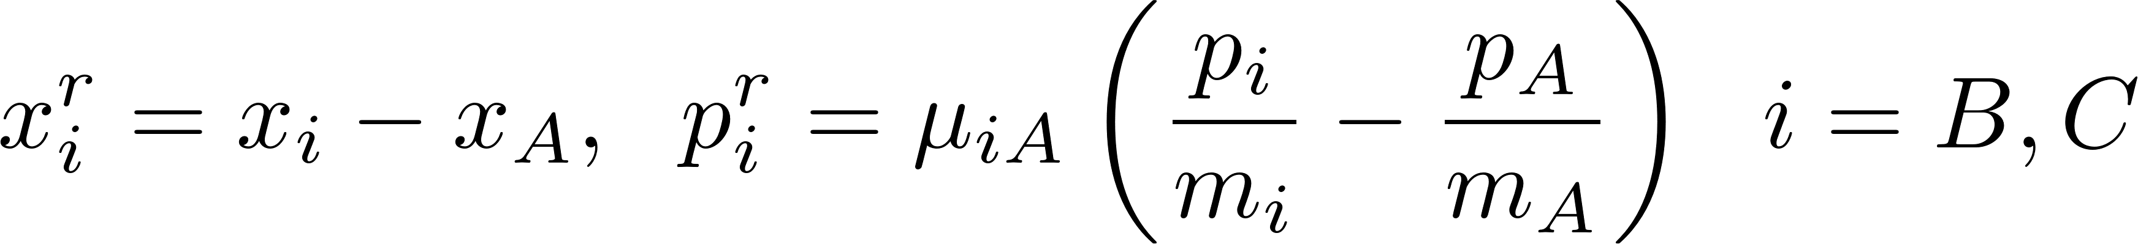
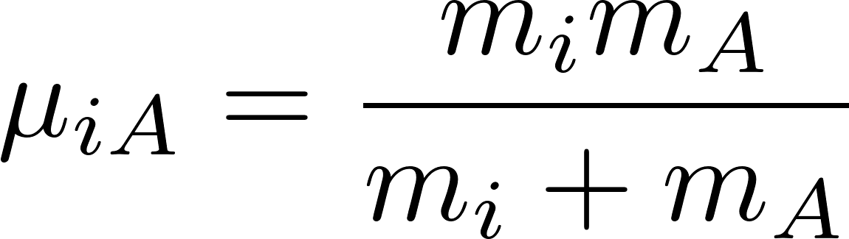
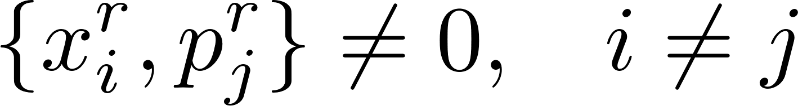
What does not work …
“New QRF”
A
B
… is taking both relative coordinates a relative momenta.
“System”
C
“Old QRF”
where is reduced mass
Not canonical: No guarantees of having the Hamiltonian formalism.

Slide 14
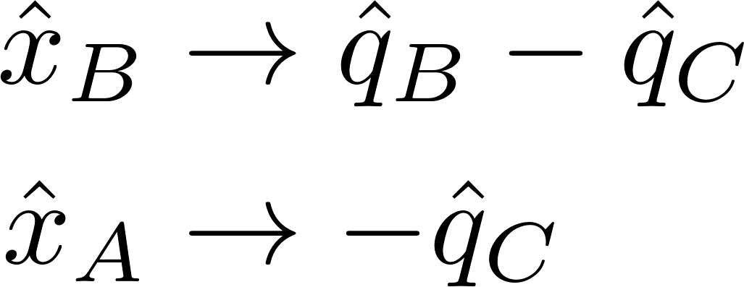
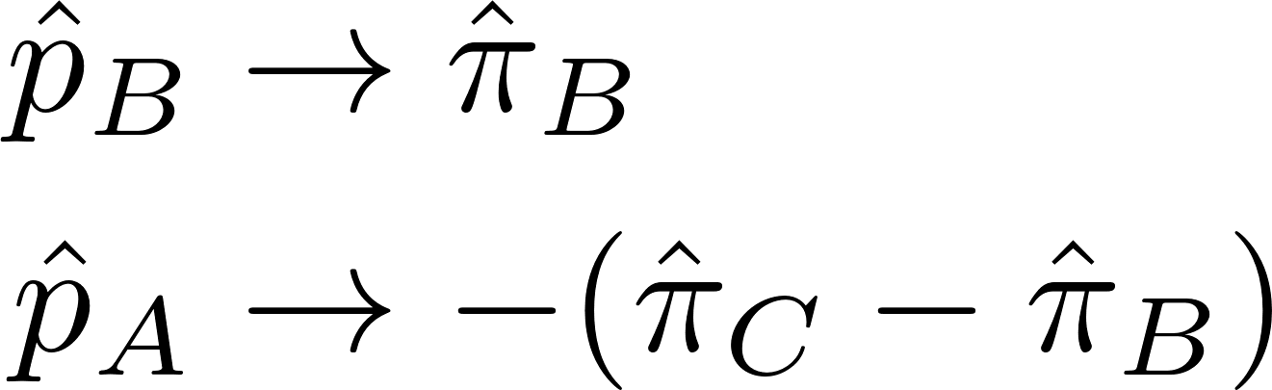
Relative positions
We choose the relative quantity we are interested in and then complete the transformation canonically.

Slide 15
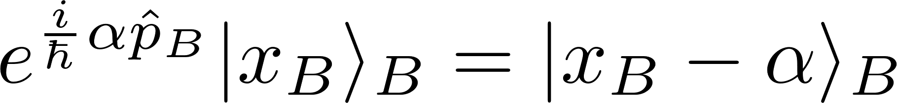
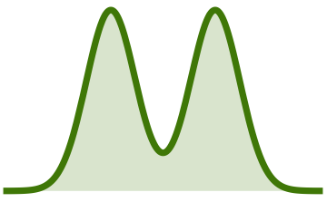
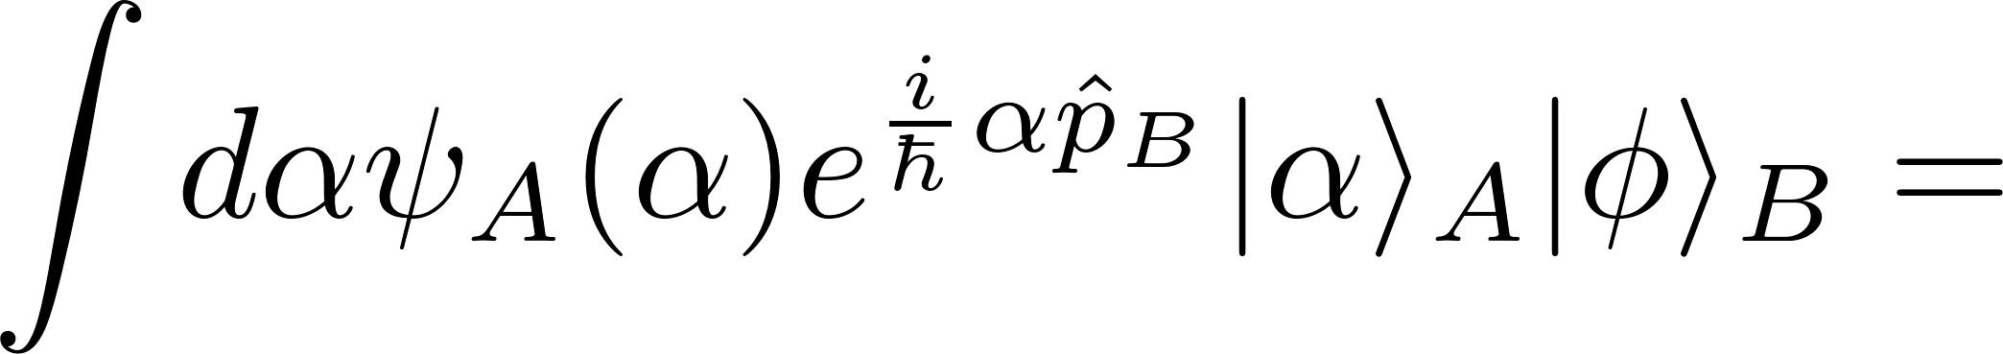
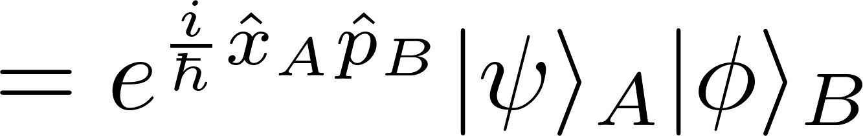
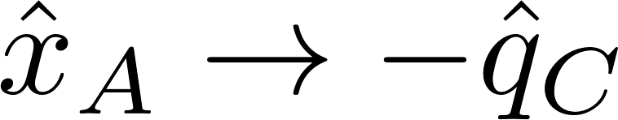
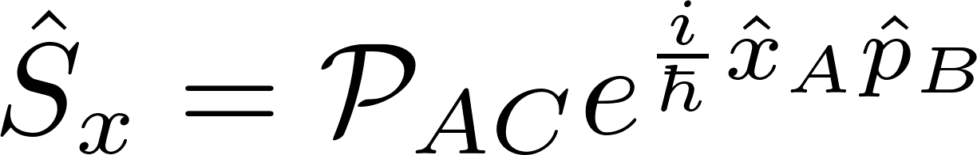
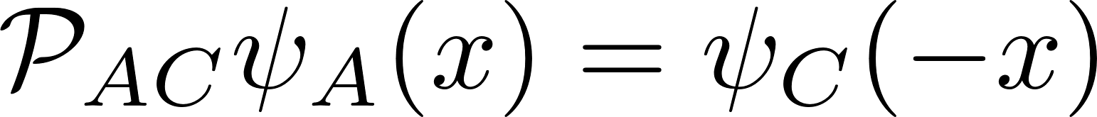
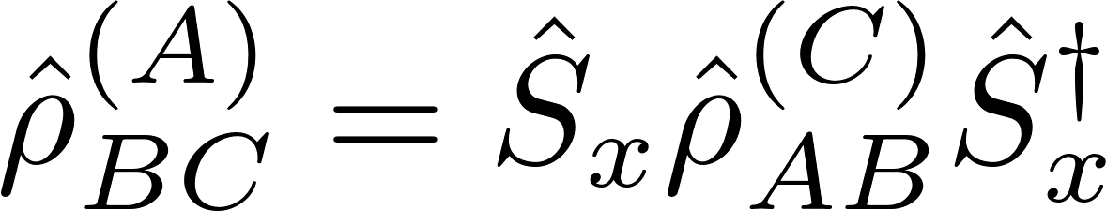
“Superpositions of spatial translation”
Classical RF:
A
B
Quantum RF:
A
B
Because of :
Parameter promoted to an operator
Parity-Swap Operator:
State of B & C as seen from A
State of A & B as seen from C

Slide 16
Examples of “relative quantum states”
Localised state of A
Product state
Entangled state
EPR state

Slide 17
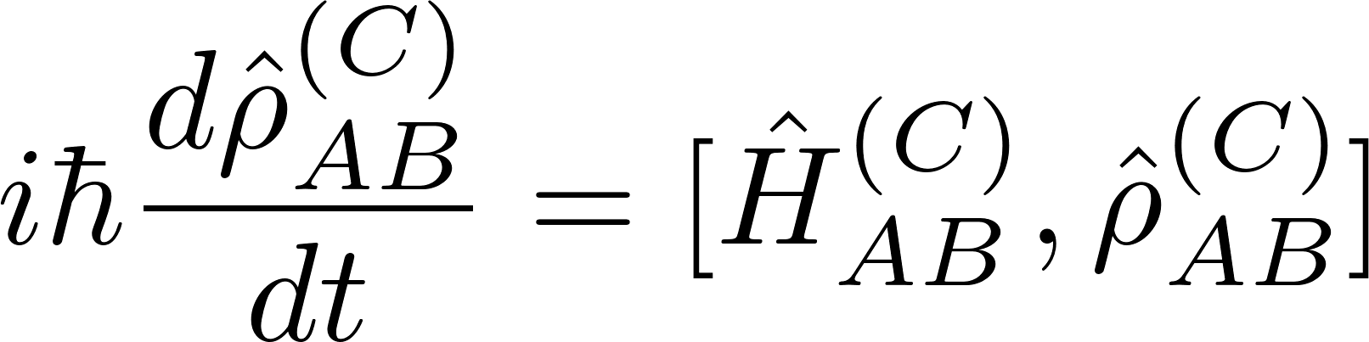
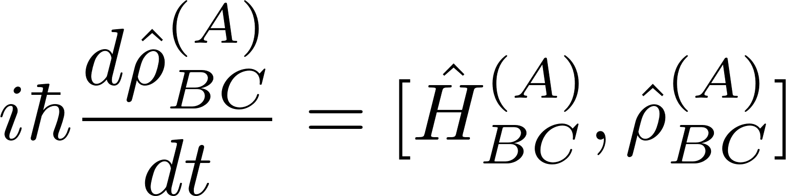
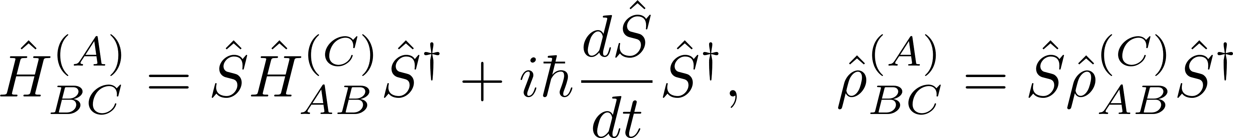
Dynamical quantum reference frames
A Hamiltonian is assigned to all systems “external” to a QRF.
Schrödinger equation in C’s reference frame
“New QRF”
A
B
“System”
Schrödinger equation in A’s reference frame
C
“Old QRF”
We define a symmetry transformation as:
It leaves the functional form of the Hamiltonian invariant.

Slide 18
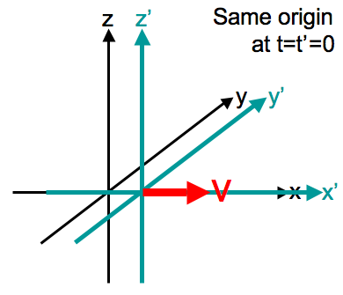
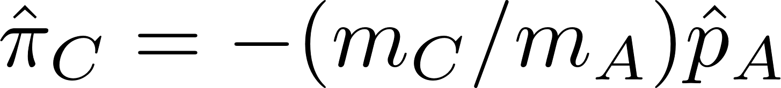
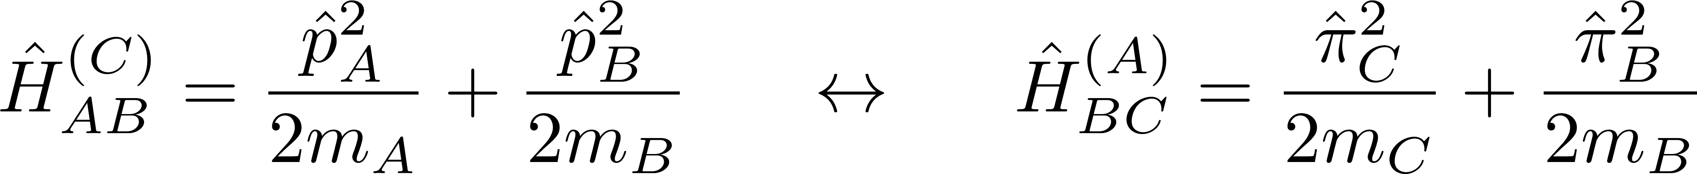
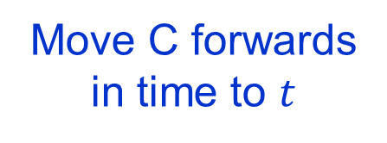
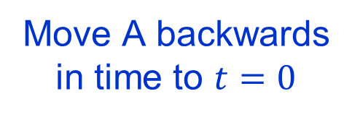
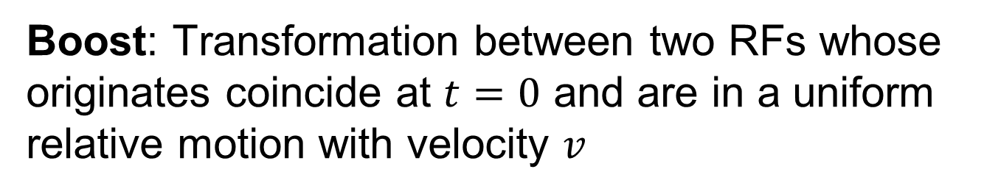
“Superpositions of boosts”
Boost: Transformation between two RFs whose originates coincide at $t=0$ and are in a uniform relative motion with velocity $v$
Parity + Swap: Sets velocity of C to the opposite of velocity of A:
Move C forwards in time to $t$
Galilean boost conditioned by the velocity of A
Move A backwards in time to $t=0$
The free Hamiltonian is symmetric under generalized boosts.

Slide 19
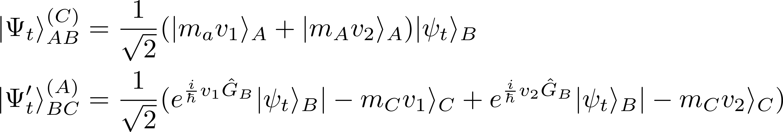
Examples of “relative states”
System A in a superposition of velocities from the point of view of the initial reference frame C and vice versa.
From C:
From A:

Slide 20
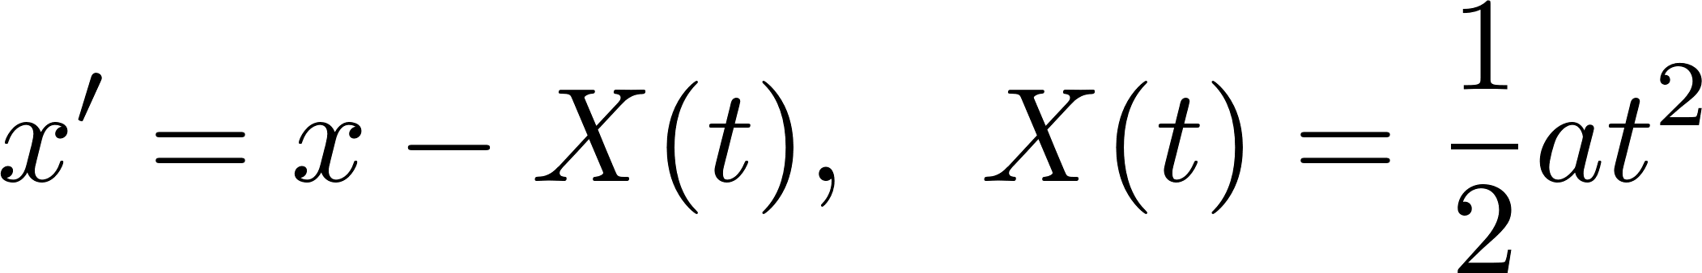


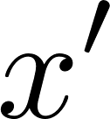
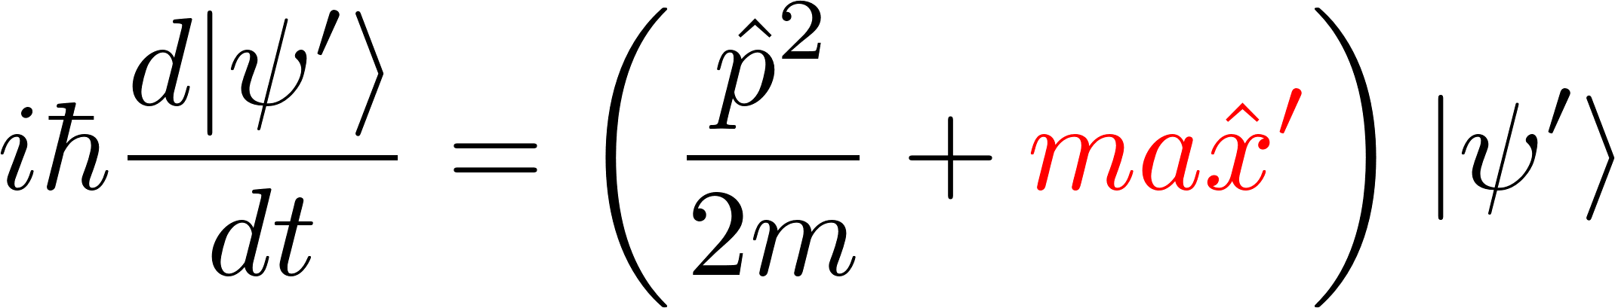
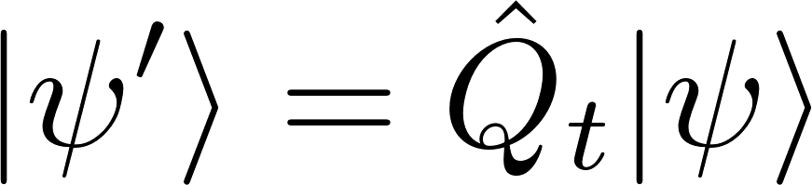
Weak equivalence principle
The physical effects as seen from a reference frame moving with constant and uniform acceleration are indistinguishable from those as seen in a uniform gravitational field.
RF
RF’
Greenberger operator:
D. M. Greenberger, Am. J. Phys. 47.1 (1979) 35-38.

Slide 21
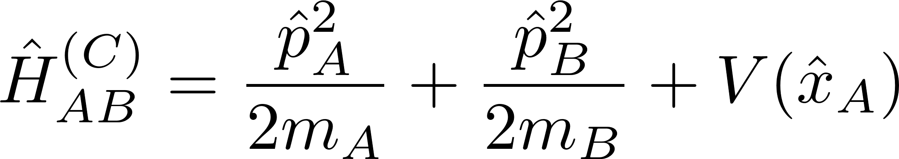

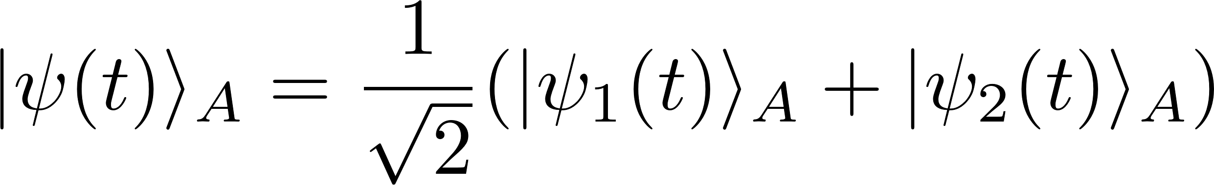
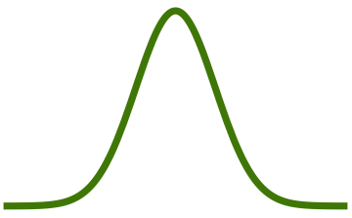


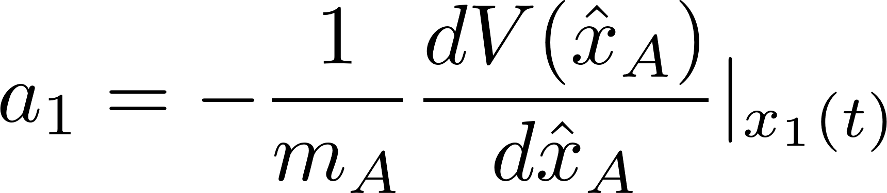
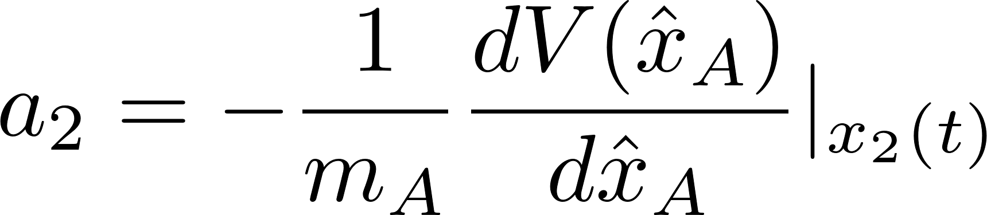




Weak equivalence principle for QRFs
The physical effects as seen from a reference frame moving in a „superposition of constant and uniform accelerations“ are indistinguishable from those as seen in a „superposition of uniform gravitational fields“.
From C:
Piecewise linear potential
Generalization of the Greenberger operator

Slide 22
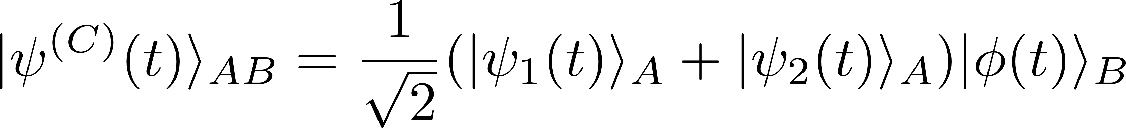
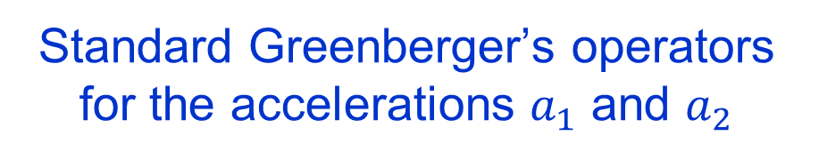
From C
Weak equivalence principle for QRFs
From
B moves as if it were in a superposition of gravitational fields
From A
Standard Greenberger’s operators for the accelerations $a_{1}$ and $a_{2}$
Experimental Tests?

Slide 23
But is it good for anything?

Slide 24

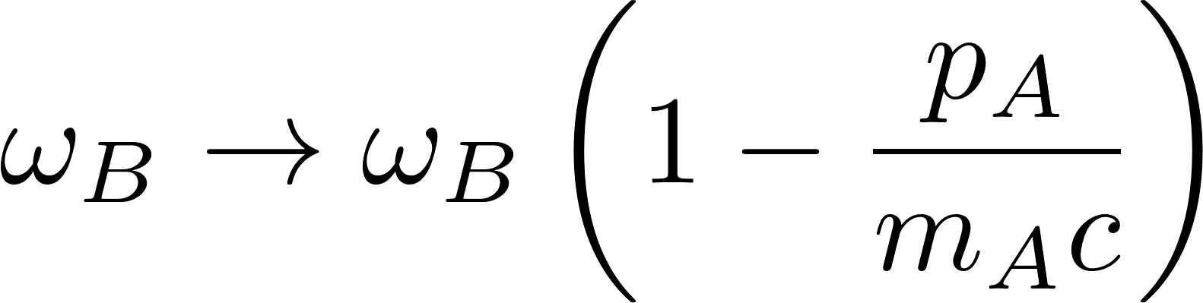





“Moving” in the rest frame
Lab’s RF:
Photon (B)
Atom (A)
Transition frequency in the rest frame
Doppler shift
Suppose that atom’s velocity is not well-defined in the lab frame.
Under which conditions can a photon and the atom get in resonance?
Lab’s RF:
Photon (B)
Atom (A)
Move in the rest frame.
Solve the problem.
Move back in the lab frame.

Slide 25

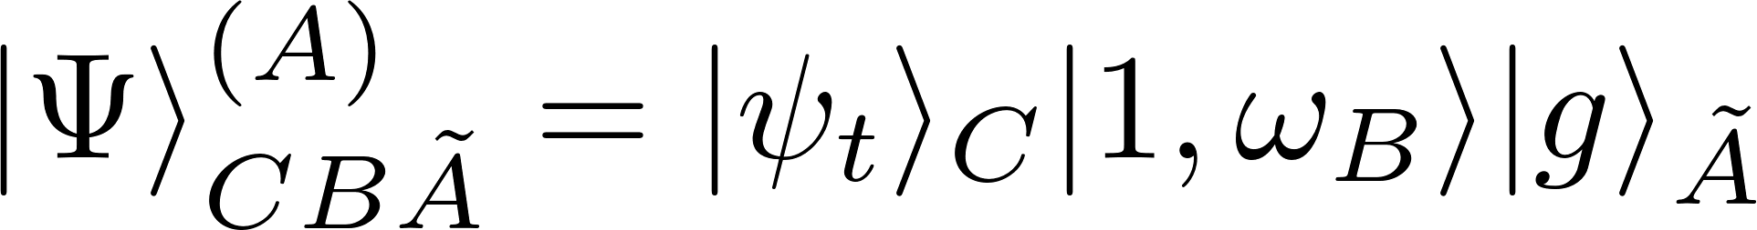
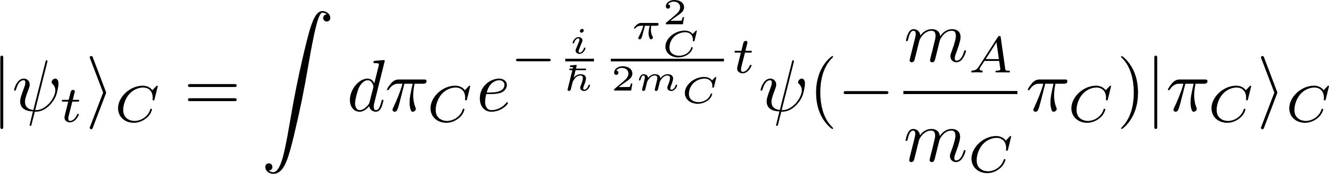
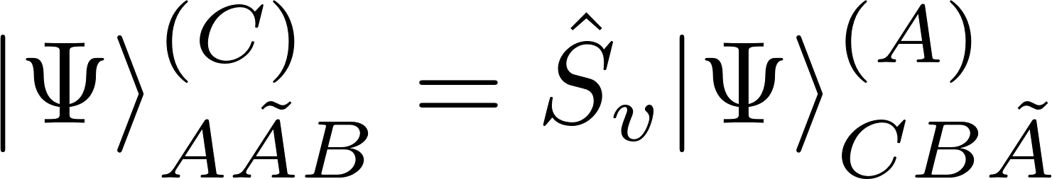
“Moving” in the rest frame
Transition frequency in the rest frame
Lab (C)
Photon (B)
Atom (A)
Atom’s RF (A)
Ground state
Lab(C)
Photon (B)
Atom (A)
Lab’s RF (C)
Conditional Doppler-shift

Slide 26
Solving an open problem
How to encode and decode qubit using the angular momentum of a relativistic particle?

Slide 27
Solving an open problem
Move in the rest frame
Define spin in the rest frame via the Stern-Gerlach experiment
Move back in the lab frame

Slide 28
Summary
Operational approach: reference frames as physical systems obeying quantum mechanical laws
Generalization of the covariance law and symmetries to quantum reference frames
“Superpositions of spatial translations”
“Superposition of Galilean boosts”
Generalization of the weak equivalence principle to quantum reference frames
*A relativistic spin operator satisfying the spin algebra, with the correct eigenvalues and the correct nonrelativistic limit

Slide 29




Thank you!
quantumfoundations.org

Slide 30




Stern-Gerlach Experiment
Only valid in the non-relativistic limit

Slide 31







Spin in Special Relativity
$$t$$
$$θ(p^{μ})$$
$$U(Λ_{p})$$
Lorentz boost
The alignment of the magnet depends on the momentum of the particle.
$$x$$
State of momentum and spin in the rest frame
$$t$$
State of momentum and spin in the lab frame
Rotated spin
Superposition of momenta?
$$x$$

Slide 32



Spin in Special Relativity
$$t$$
$$θ(p^{μ})$$
A general quantum state is written as
Move in the rest frame
Define spin in the rest frame via the Stern-Gerlach experiment
Move back in the lab frame
$$x$$
lab
spin
momentum

Slide 33








Lorentz boost in QRFs
spin
lab
In the rest frame of the particle (A):
Lorentz boost by each velocity of the laboratory
relative to the particle
where
guarantees that
In the laboratory frame (C):
momentum
spin

Slide 34




Spin Operator
With the QRF transformation, we can operationally identify a spin operator which gives the same results in the laboratory frame and in the rest frame.
Correct non-relativistic limit
su(2) algebra
Correct eigenvalues
The state in the laboratory frame

Slide 35



Spin Operator
Partition of the total Hilbert space
$$|0⟩$$
$$|1⟩$$
Effectively, we can treat the relativistic spin as a qubit with quantum reference frames!

Slide 36
Summary
Operational approach: reference frames as physical systems obeying quantum mechanical laws
Generalization of the covariance law and symmetries to quantum reference frames
“Superpositions of spatial translations”
“Superposition of Galilean boosts”
Generalization of the weak equivalence principle to quantum reference frames
A relativistic spin operator satisfying the spin algebra, with the correct eigenvalues and the correct nonrelativistic limit

Slide 37
Thank you!
quantumfoundations.org

Slide 38


General transformation
Transformations from abstract RFs:
Function describing the relationship between old and new reference frame, e.g.
Transformations from quantum RFs:
Hamiltonian of the old RF C as seen from the new one A
Time-dependent operator
Hamiltonian of the new RF A as seen from the old one C
Maping C back to the Schrödinger picture
Maping A to the Heisenberg picture
Parity operator (switches the equations of motion of A and C)

Slide 39



“Jumping” in the rest frame of a quantum particle
Suppose that an atom does not have a well-defined momentum in the lab frame. Under which conditions can a photon and the atom get in resonance?
From A (the rest frame of the atom):
Photon
Atom’s level
Lab
From C:
Photon
Atom
Atom’s level
„Conditional Doppler-shift“

Slide 40
“Jumping” in the rest frame of a quantum particle
Suppose that an atom moves with a well-defined momentum in the lab frame. Under which conditions can a photon and the atom get in resonance?
Photon
Atom’s level
Lab
Transition frequency in the rest frame
Doppler shift

Slide 41
“Jumping” in the rest frame of a quantum particle
Suppose that an atom does not have a well-defined momentum in the lab frame. Under which conditions can a photon and the atom get in resonance?
From A (the rest frame of the atom):
Photon
Atom’s level
Lab
From C:
Photon
Atom
Atom’s level
„Conditional Doppler-shift“

Slide 42

Measurements in QRFs
The observed probabilities are invariant of the reference frame („generalized Wigner‘s theorem“).

Slide 43












Spin in Special Relativity
…and many more!

Slide 44

Spin in Special Relativity
Bauke, Ahrens, Keitel, Grobe (2014)
Desiderata for a covariant spin operator:
Satisfies the su(2) algebra;
Has eigenvalues ;
Has the correct non-relativistic limit.
Problems:
Most of the proposed operators do not satisfy all these criteria
No experimental guidance
Important for encoding and decoding quantum information in the relativistic spin. Where is the qubit?

Slide 45







Spin operator
With the quantum reference frame transformation, we can operationally identify a spin operator which gives the same results in the laboratory frame and in the rest frame.
Foldy-Wouthuysen or Pryce spin operator
Pauli-Lubanski operator
$$Ξ_{i}={\overset{̂}{S}}_{L}(I_{C}⊗σ_{i}){\overset{̂}{S}}_{L}^{†}$$
Correct non relativistic limit
su(2) algebra
State of the particle in the laboratory frame
Correct eigenvalues
Bauke, Ahrens, Keitel, Grobe (2014)
11/14

Slide 46





Spin measurement
In the rest frame A:
spin
laboratory
$$H_{int}^{(A)}=μ{\overset{⃗}{B}}^{(A)}⋅\overset{⃗}{σ}$$
$$−v_{1}$$
$$−v_{2}$$
In the laboratory frame C:
particle
$$v_{1}$$
$$v_{2}$$
$$H_{int}^{(C)}=μ\left[\overset{⃗}{Ξ}−\frac{γ_{A}}{γ_{A}+1}\left(\overset{⃗}{Ξ}⋅{\overset{⃗}{β}}_{A}\right){\overset{⃗}{β}}_{A}\right]⋅{\overset{⃗}{B}}^{(C)}+μ\left(\overset{⃗}{Ξ}×{\overset{⃗}{β}}_{A}\right)⋅{\overset{⃗}{E}}^{(C)}$$
13/14

