Slide 1
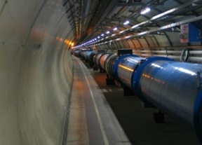
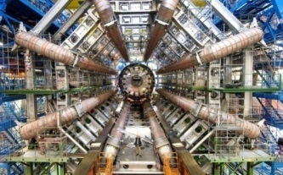
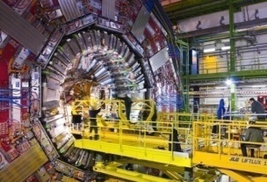
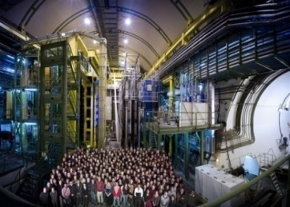
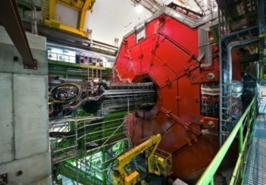
The LHC and its path to high performance
Wien, Teilchenphysik Seminar
Verena Kain
CERN Beams Department
Operations group
Acknowledgments to J. Wenninger and other OP colleagues for plots and slides

Slide 2
Outline
Introduction
LHC magnets and early commissioning
LHC performance 2010-2012
Mastering the challenges
Towards top energy

Slide 3
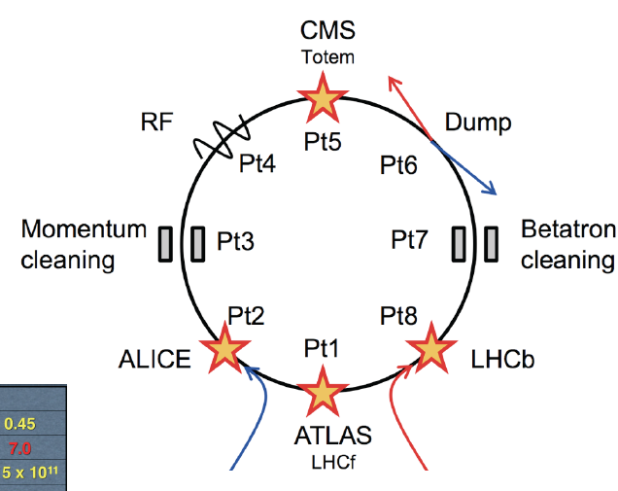






LHC layout and parameters
Total length 26.66 km, in the former LEP tunnel.
8 arcs (sectors), ~3 km each.
8 straight sections of 700 m.
beams cross in 4 points.
2-in-1 magnet design with separate vacuum chambers.
The LHC can be operated with protons and ions (so far Pb₂₀₈).

Slide 4

The Large Hadron Collider LHC
Installed in 26.7 km LEP tunnel
Depth of 70-140 m
Lake of Geneva
LHC ring
Control Room
SPS ring

Slide 5


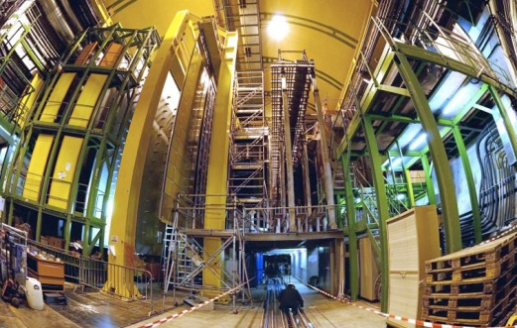
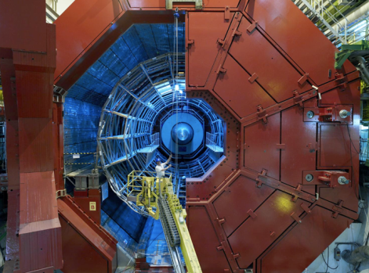

The Large Hadron Collider LHC
Installed in 26.7 km LEP tunnel
Depth of 70-140 m
Lake of Geneva
CMS
LHC ring
LHCb
LHC ring
Control Room
SPS ring
ALICE
ATLAS

Slide 6
Outline
Introduction
LHC magnets and early commissioning
LHC performance 2010-2012
Mastering the challenges
Towards top energy

Slide 7
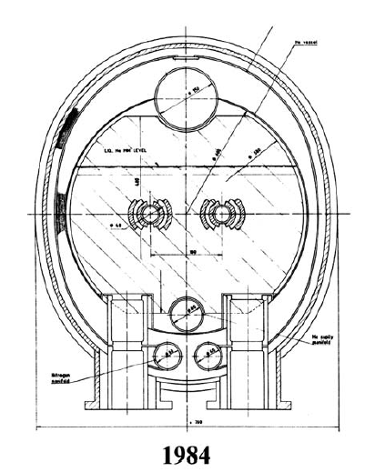
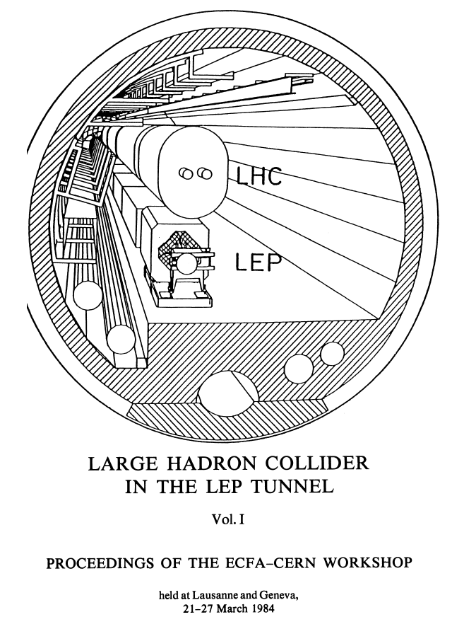
‘Bold beginning’
Challenges & choices:
High magnetic fields,
2 in 1 design,
Superfluid Helium,
Luminosity ~1×10³³ cm⁻²s⁻¹
  Limit to 4 events / bunch crossing !
Parameters remained rather stable over time, except for luminosity:
Pushed to ~1×10³⁴ cm⁻²s⁻¹ to compete with SSC.

Slide 8
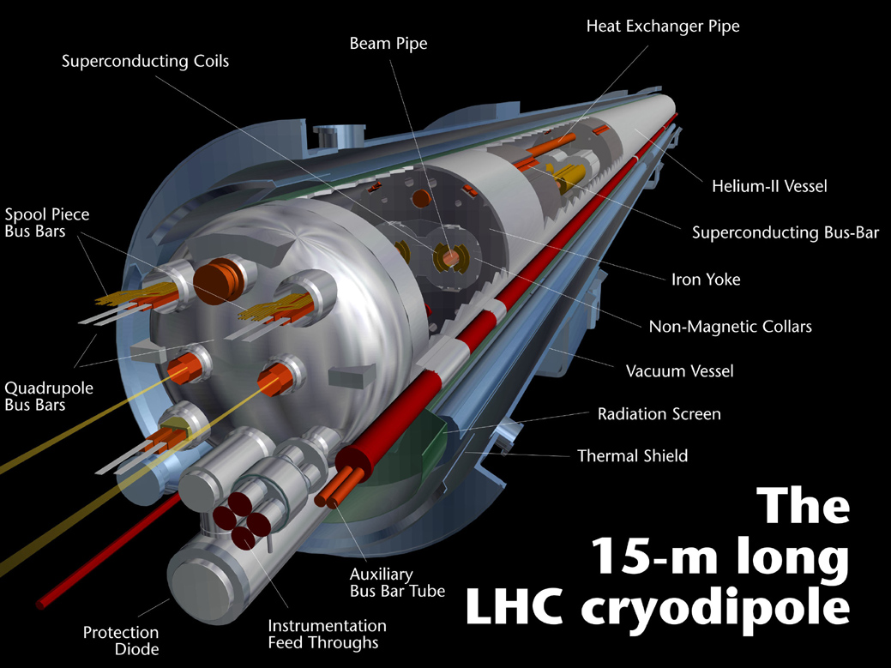
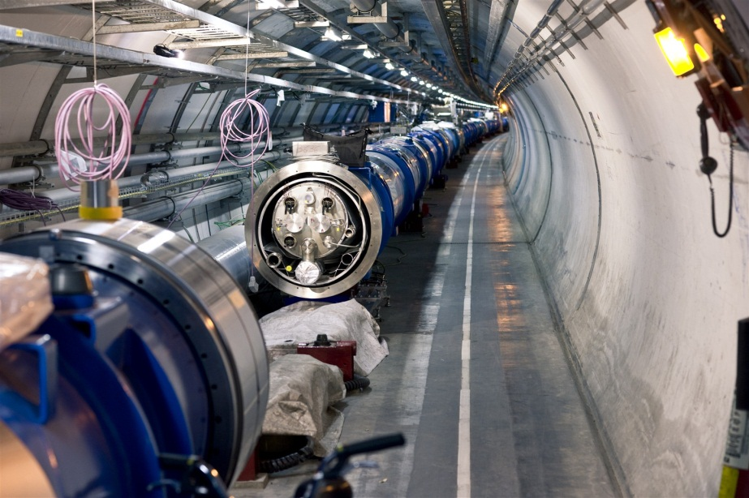
Beautiful technology
1232 NbTi superconducting dipole magnets – each 15 m long
Magnetic field of 8.3 T (current of 11.8 kA) @ 1.9 K (super-fluid Helium).
  But they do not like beam loss – quench with few mJ/cm³.

Slide 9
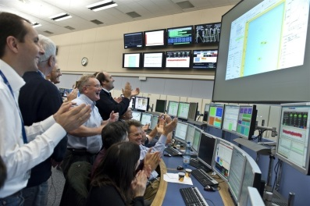
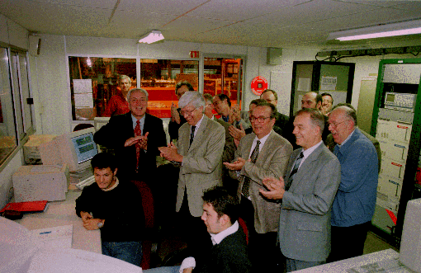
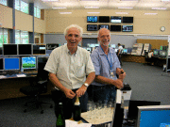
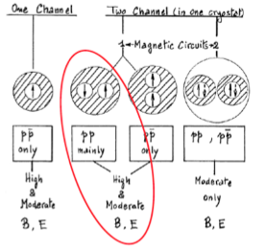
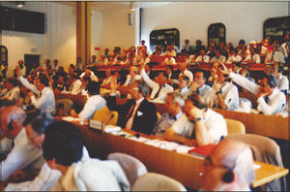
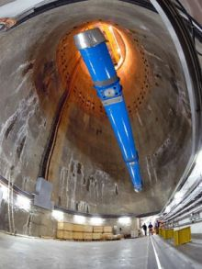
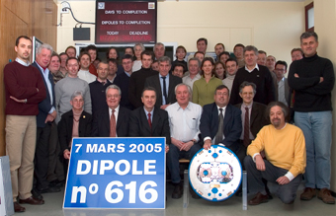
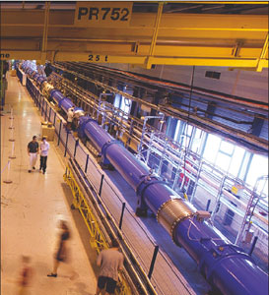

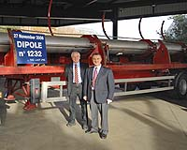
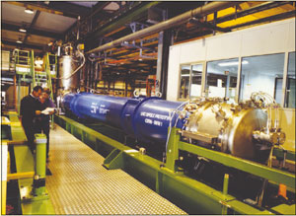
June 1994
first full scale prototype dipole
June 2007 First sector cold
1984
ECFA-CERN workshop
November 2009
Start of Run 1
April 2008
Last dipole down
1994 project approved by council
1984
90
91
92
93
94
95
96
97
98
99
00
01
02
03
04
05
06
07
08
09
10
2002 String 2
November 2006
1232 delivered
September 2008
First set of twin 1 m prototypes
Over 9 T
9

Slide 10
LHC energy evolution
Energy (TeV)
7 TeV
Design
5 TeV
Magnet de-training after installation
2007
2008
2009
2010
2011
2012
2013
2014
2015

Slide 11

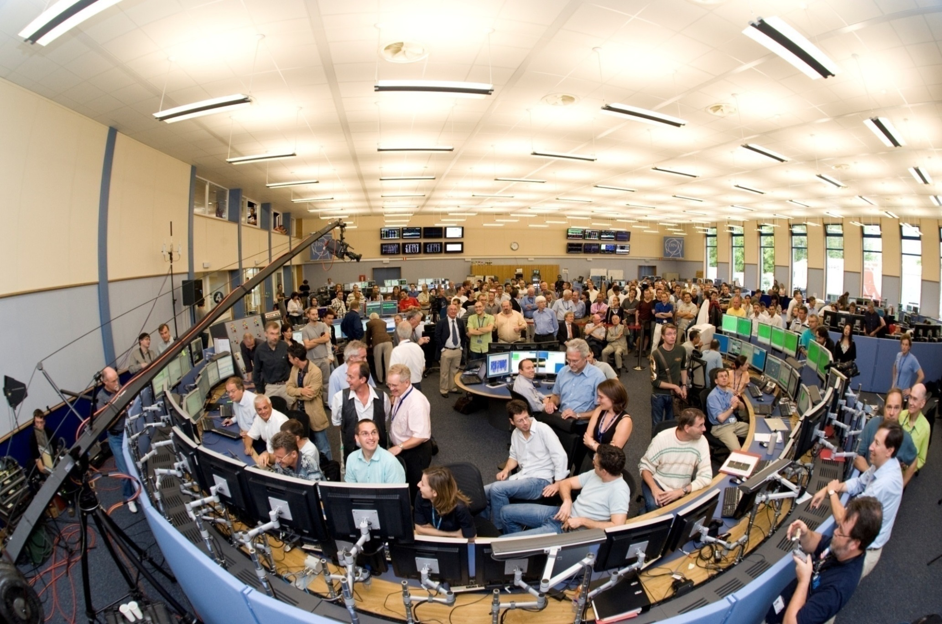
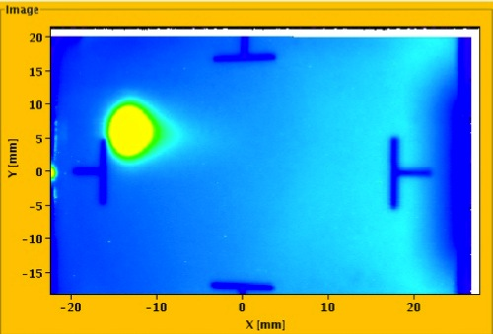
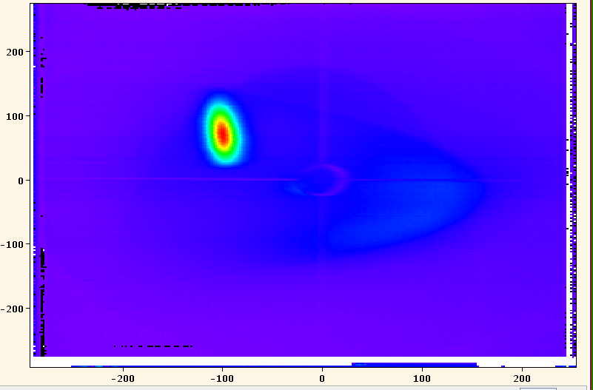
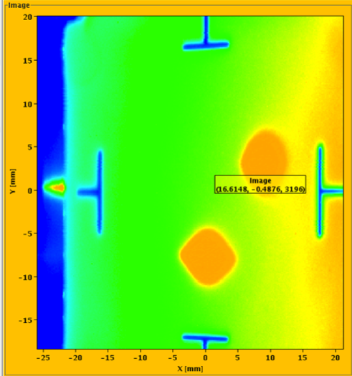
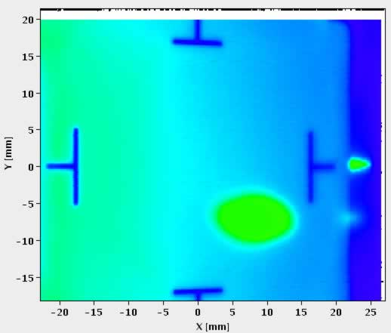
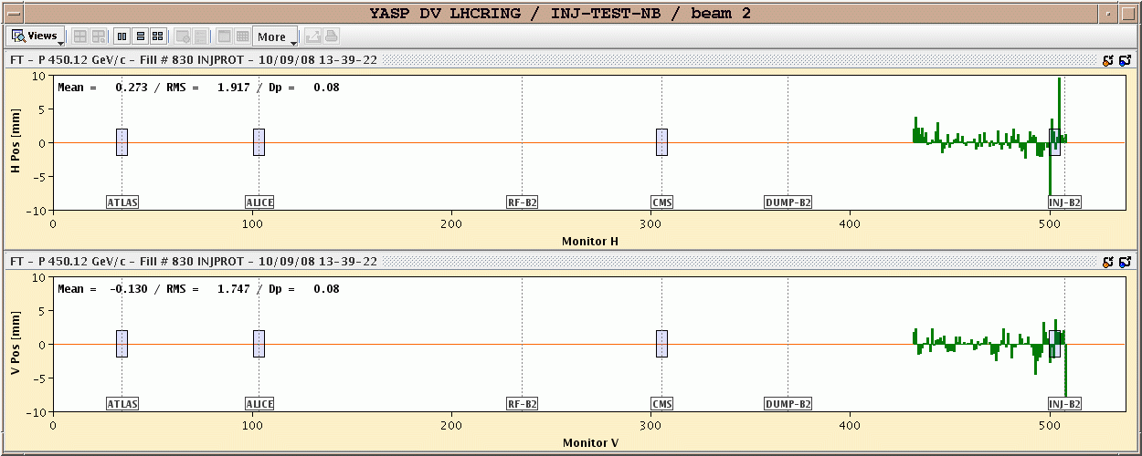
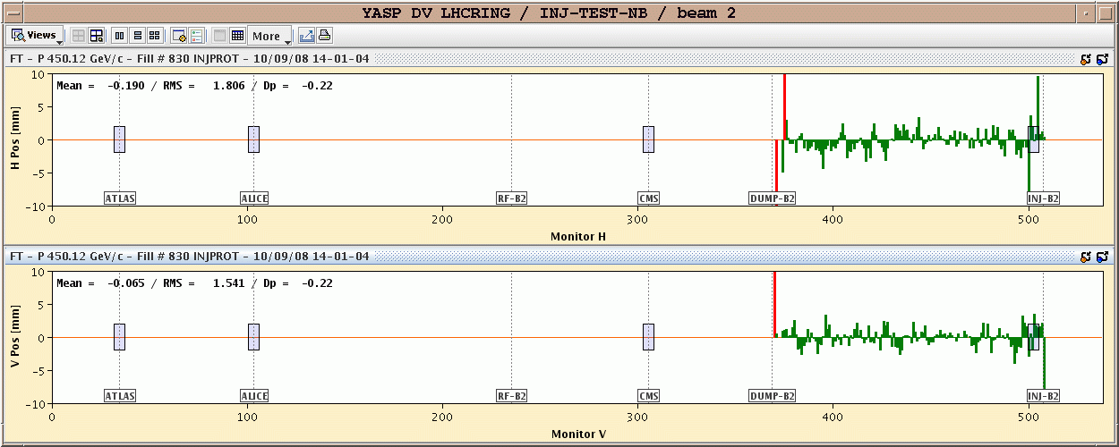
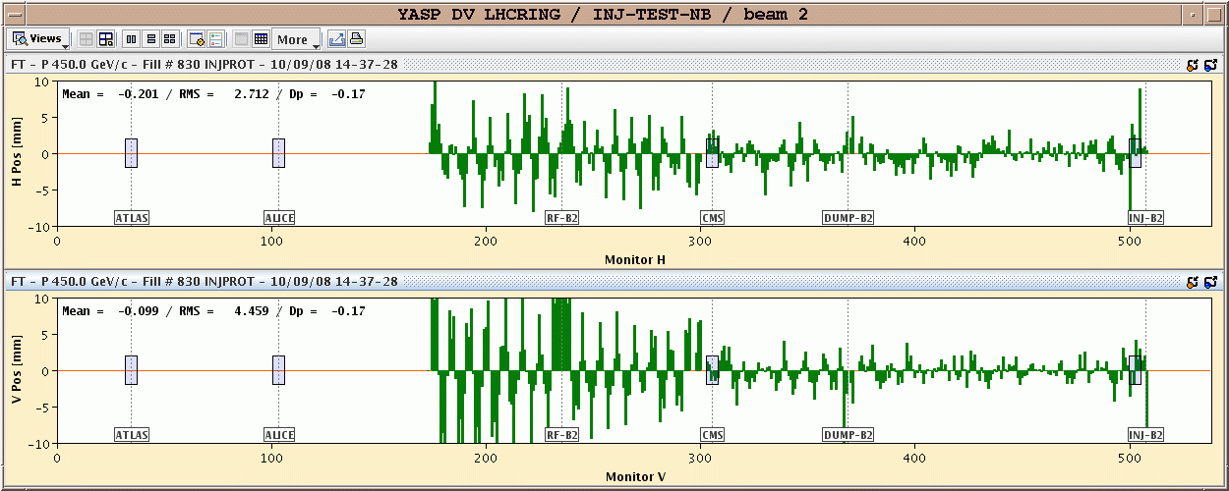
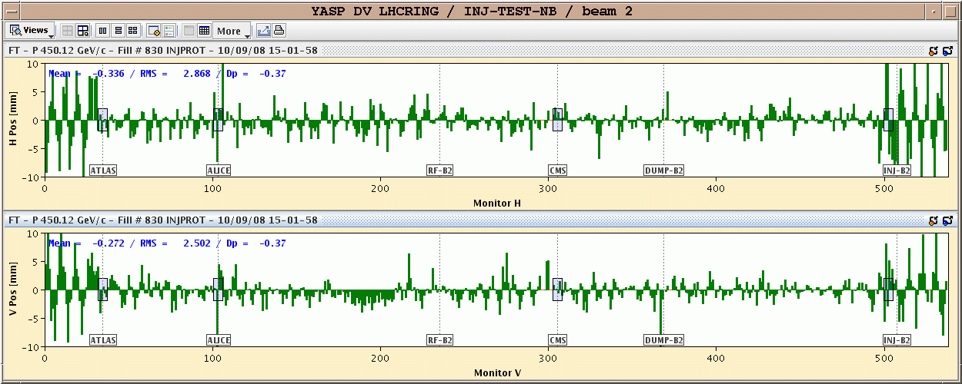
September 10th 2008
A brief moment of glory
IR3
IR6
First turn !
IR7

Slide 12
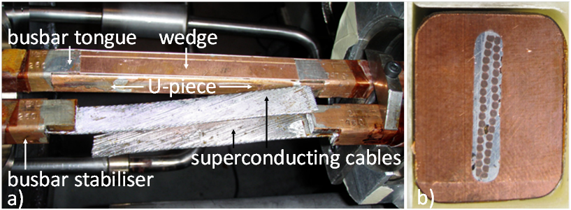
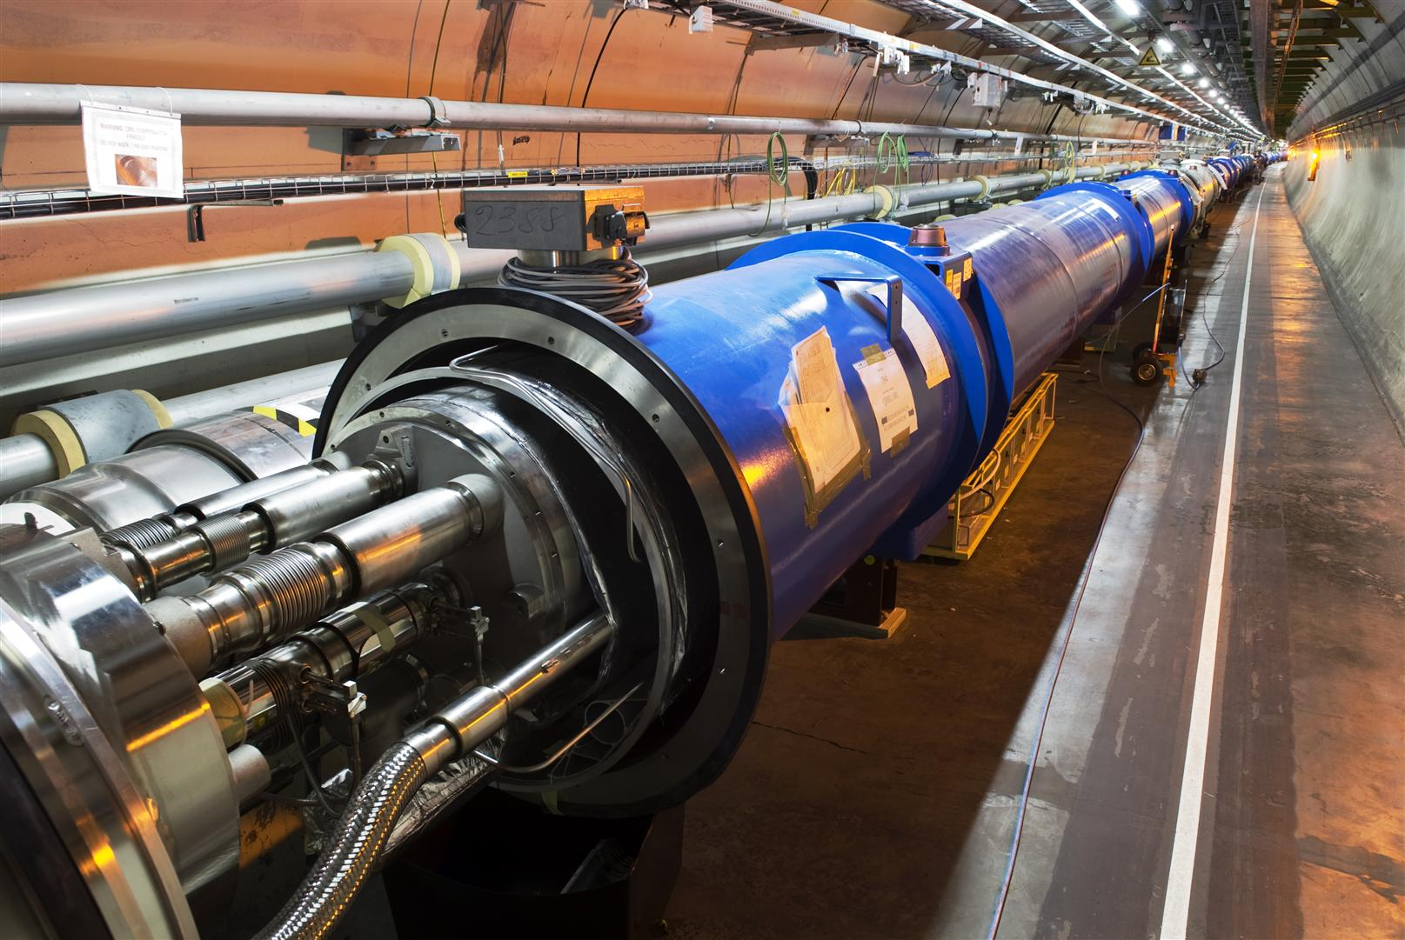
LHC magnet interconnection
On 19th September magnet interconnections became the hot topic for more than 1 year

Slide 13
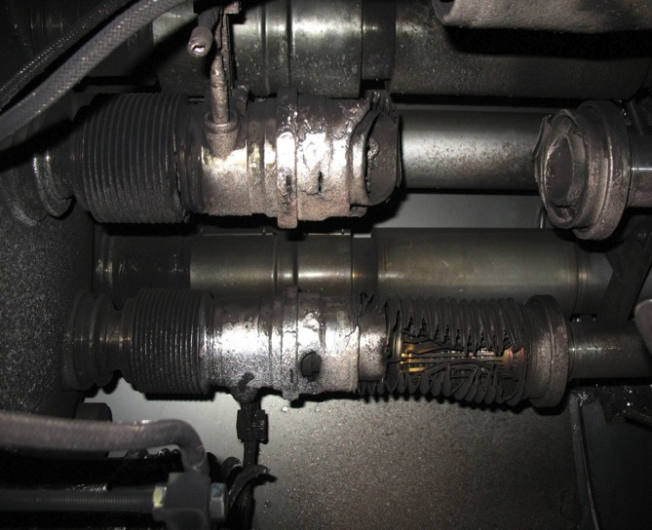
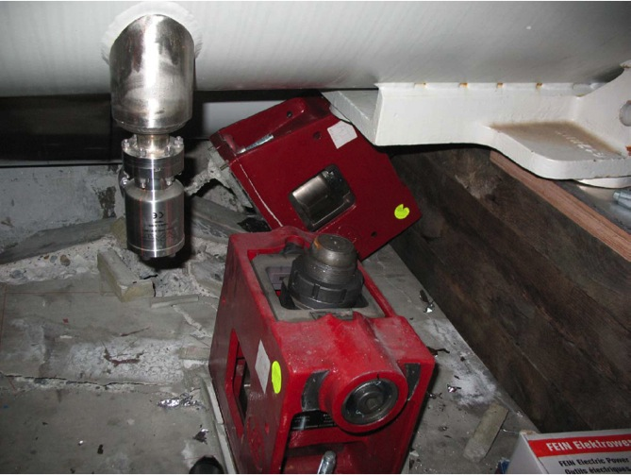

Incident September 19th 2008
An electrical arc in a defect interconnection provoked a He pressure wave that damaged ~700 m of the LHC and polluted the beam vacuum over more than 2 km…
Arcing in the interconnection
Over-pressure
53 magnets had to be repaired
Magnet displacement

Slide 14
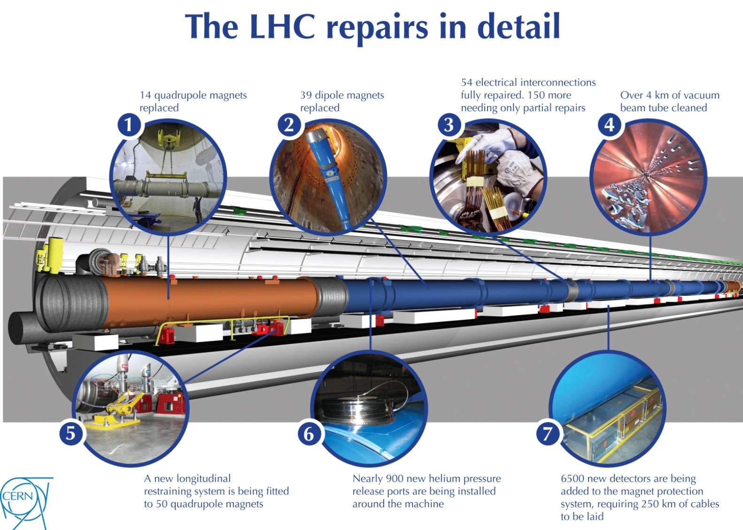
LHC repair and consolidation
14 quadrupole magnets replaced
39 dipole magnets replaced
204 electrical inter-connections repaired
Over 4km of vacuum beam tube cleaned
New longitudinal restraining system for 50 quadrupoles
Almost 900 new helium pressure release ports
6500 new detectors and 250km cables for new Quench Protection System to protect from busbar quenches
Collateral damage mitigation

Slide 15
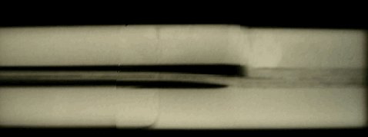
More problems on the joints
The copper stabilizes the bus bar in the event of a cable quench (=bypass for the current while the energy is extracted from the circuit).
    Protection system in place in 2008 not sufficiently sensitive.
A copper bus bar with reduced continuity coupled to a badly soldered superconducting cable can lead to a serious incident.
Solder
No solder
wedge
bus
U-profile
bus
X-ray
During repair work, inspection of the joints revealed systematic voids caused by the welding procedure.
Energy limitation for run 1 !!

Slide 16
LHC Energy Evolution
Energy (TeV)
7 TeV
Design
5 TeV
Magnet de-training after installation
Joint problems,
incident
3.5 TeV
2007
2008
2009
2010
2011
2012
2013
2014
2015

Slide 17
LHC Energy Evolution
Energy (TeV)
7 TeV
Design
5 TeV
Magnet de-training after installation
Joint problems,
incident
3.5 TeV
Consolidation delays
1.18 TeV
2007
2008
2009
2010
2011
2012
2013
2014
2015

Slide 18

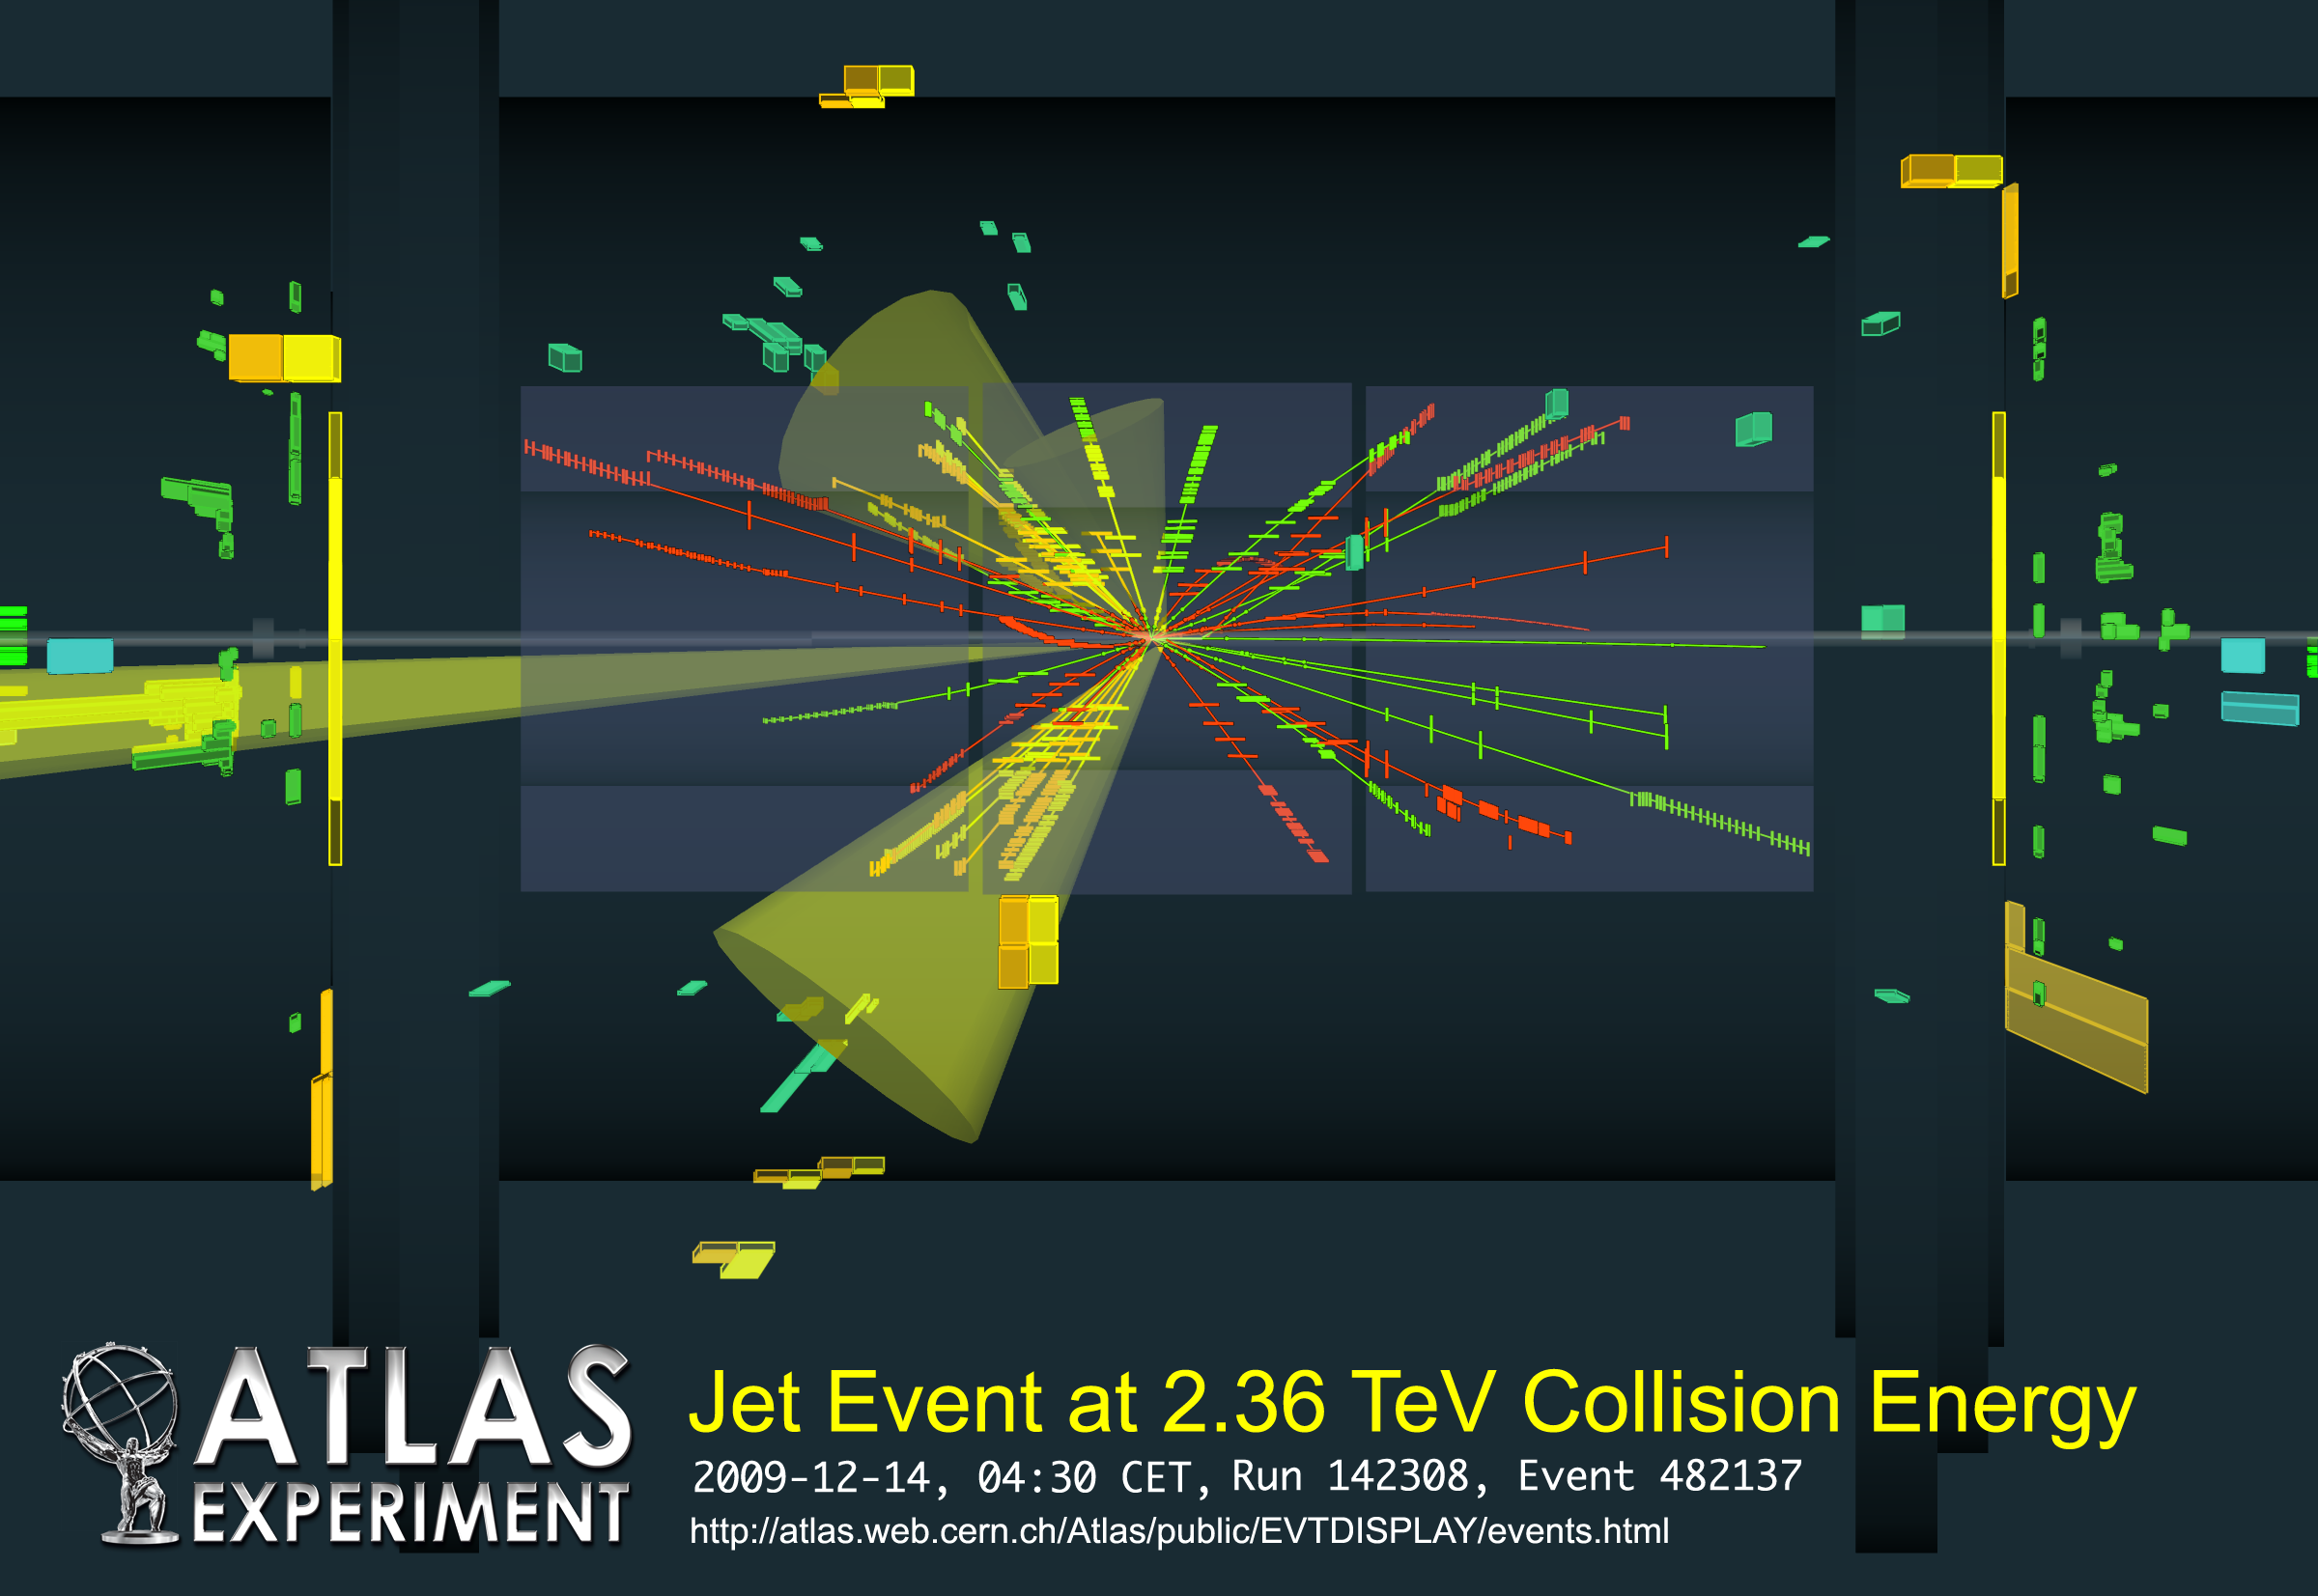
LHC is back !
29th November 2009: after 14 months of repair
3 weeks later

Slide 19
LHC Energy Evolution
Energy (TeV)
7 TeV
Design
5 TeV
Magnet de-training after installation
4 TeV
Operation
Joint problems,
incident
3.5 TeV
3.5 TeV
Operation
Consolidation delays
1.18 TeV
2007
2008
2009
2010
2011
2012
2013
2014
2015

Slide 20
Outline
Introduction
LHC magnets and early commissioning
LHC performance 2010-2012
Mastering the challenges
Towards top energy

Slide 21
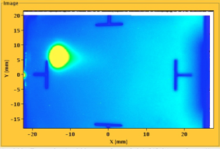
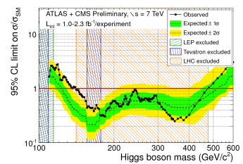


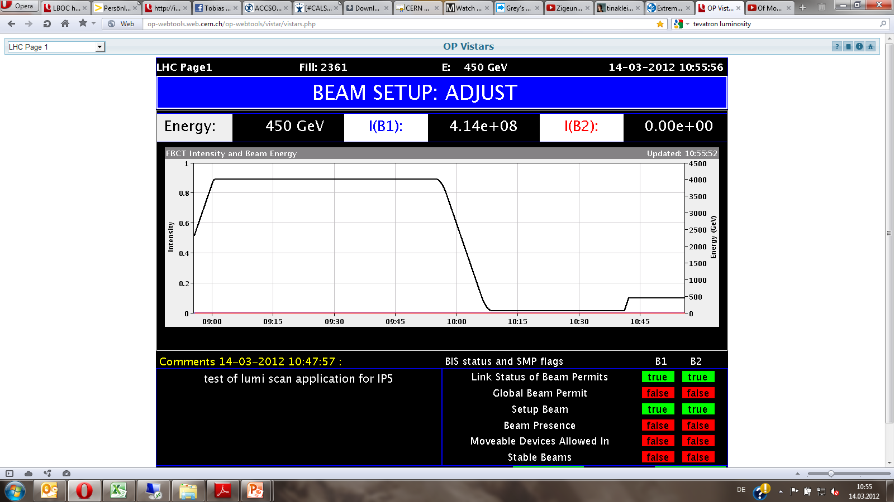


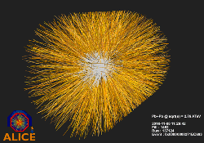
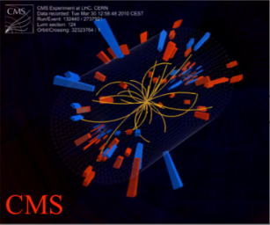
The LHC run1 timeline
August 2008
First Injection tests
December 2011
5.6 fb⁻¹
4 TeV
March 2012
4 TeV
June 28, 2011
1380 bunches
September 10, 2008
Circulating beams
November 19, 2009
Beams back
1380
2008
2009
2010
2011
2012
September 19, 2008
Incident
November 2010
First Lead ion run
July 4, 2012
Higgs Seminar
March 30, 2010
First collisions at 7 TeV CM

Slide 22
Collider luminosity
The key parameter for the experiments is the event rate dN/dt. For a physics process with cross-section σ it is proprotional to the collider Luminosity L:
unit of L :
1/(surface × time)
Population N₁
Population N₂
area A
N1 × N2
Collision rate ∝
σ ×
× encounters/second
A
L

Slide 23
Collider luminosity
The luminosity can be expressed as (for equal particle populations and Gaussian profiles) :
y
σ_{y}
σ_{x}
σ_{x},σ_{y} : transverse rms beam sizes. * refers to the IP.
β: beam enveloppe function at IP (⇔ optics).
ε : beam emittance (⇔ phase space volume).
k : number of particle packets / bunches per beam.
N : number of particles per bunch.
  k×N : total beam intensity
f : revolution frequency = 11.25 kHz.
x
LHC design
k = 2808
N = 1.15×10¹¹
σ*_{x},σ*_{y} = 16 μm
To maximize L we need:
  Large N, large k,
  Smallest possible σ.
...or some optimum combination !

Slide 24
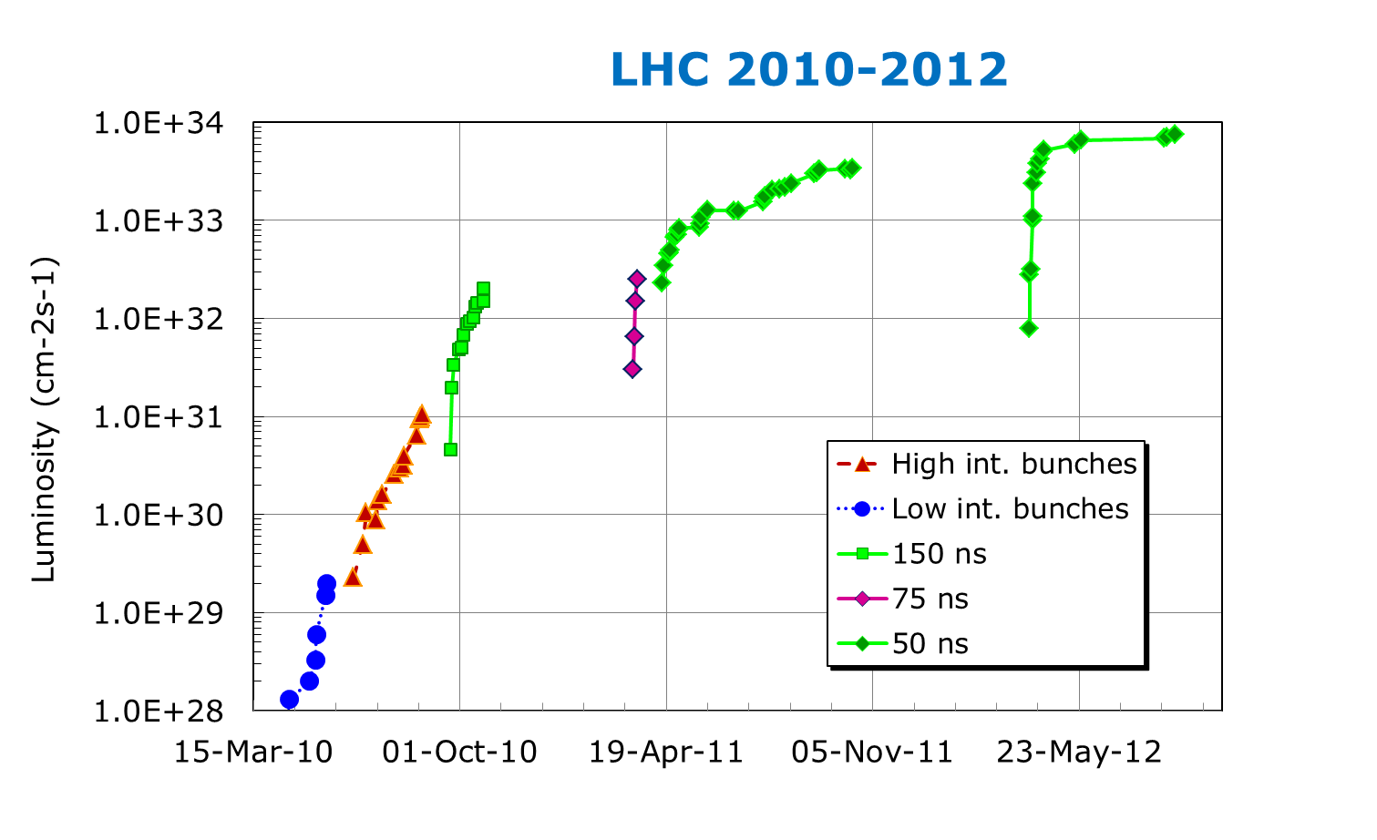
LHC progress 2010-2012
Low bunch intensity operation, first operational exp. with MPS
Ramping to 1 MJ stored energy, stability run at 1-2 MJ
Reach out for records & Higgs !
2011
2012
Peak luminosity evolution
2010

Slide 25
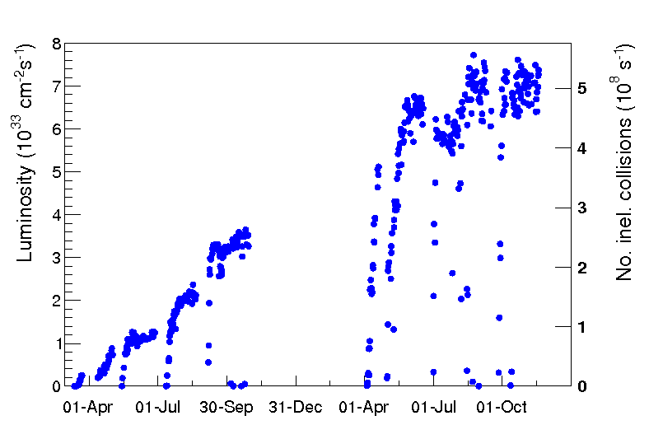
High luminosity 2011-2012
Over the last 2 years the luminosity was progressively increased:
  Through the beam intensity (mainly 2011),
  By beam size (β*) reduction at the IP.
Limited by beam stability
3.5 TeV
4 TeV
Reduce β∗ by 40%
1m → 0.6m
Reduce β∗ by 30%
1.5m → 1m
Increase N
Increase
N & k
2011
2012

Slide 26
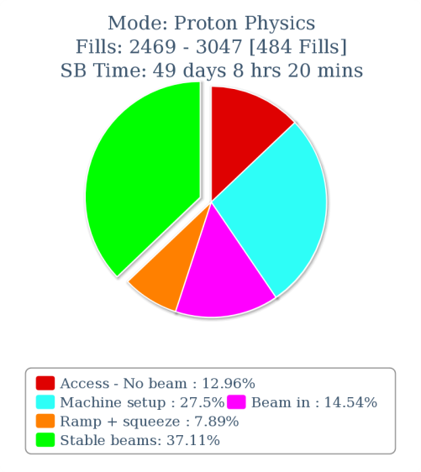
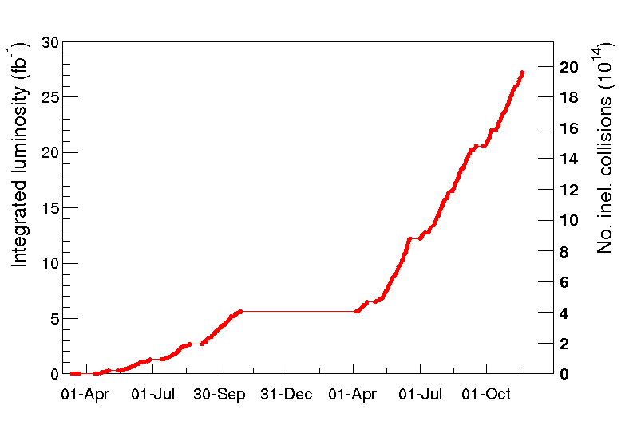

Luminosity production 2011-2012
The integrated luminosity of both ATLAS/CMS reaches now ~28 fb⁻¹ or ~2×10¹⁵ inelastic pp interactions in each detector.
  We spend 37% of the scheduled time delivering collisions to the experiments (‘stable beams’).

Slide 27
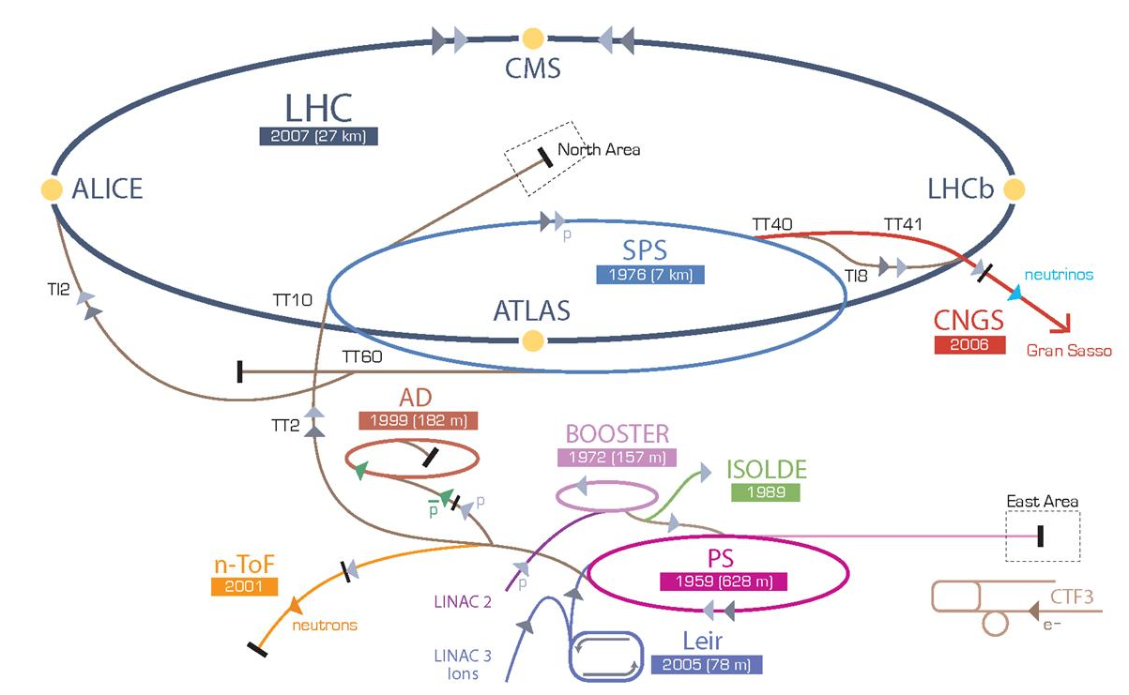
LHC 2012 versus Design
2012
4+4 TeV
50
1374
1.6×10¹¹
2.3
18
0.42 A
140 MJ
7.7×10³³
Collision energy: | 7+7 TeV
Bunch spacing (ns): | 25
Number of bunches k: | 2808
Number of particles per bunch N: | 1.15×10¹¹
Beam emittance ε (μm): | 3.75
Beam size at ATLAS/CMS (μm): | 16
Circulating beam current: | 0.58 A
Stored energy per beam: | 360 MJ
Peak luminosity (cm⁻²s⁻¹): | 10³⁴
2012 peak L scaled to 7 TeV : ~2x10³⁴

Slide 28
Outline
Introduction
LHC magnets and early commissioning
LHC performance 2010-2012
Mastering the challenges
Towards top energy

Slide 29
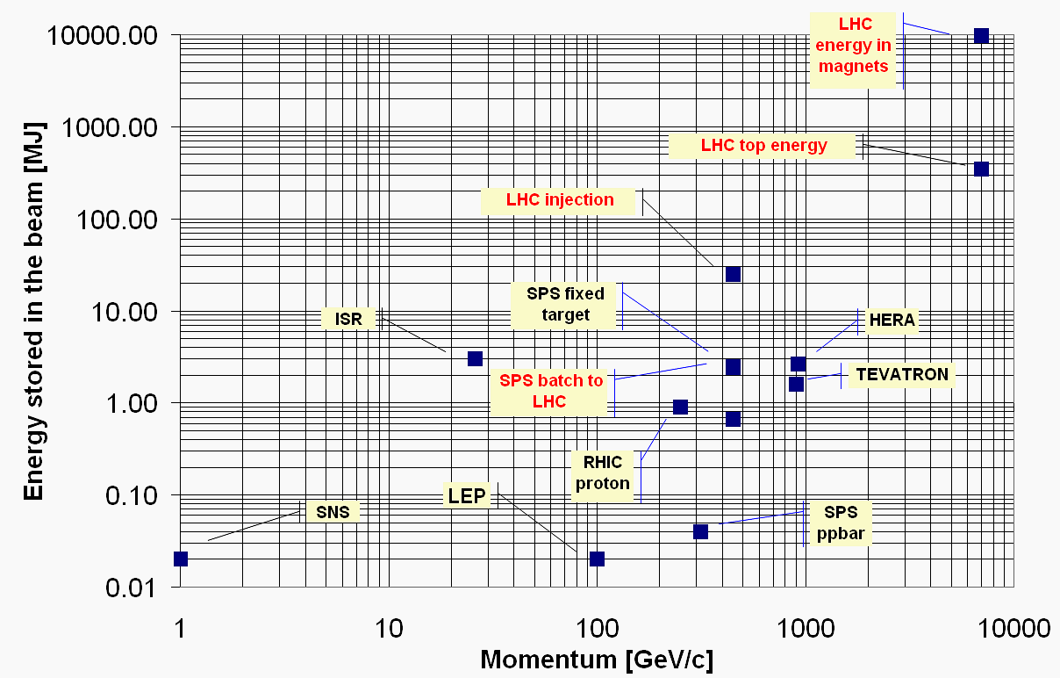
Stored energy
Superb performance of the machine protection system
LHC design : 360 MJ
4 TeV record : ~140 MJ
LHC 2012
Damage threshold

Slide 30
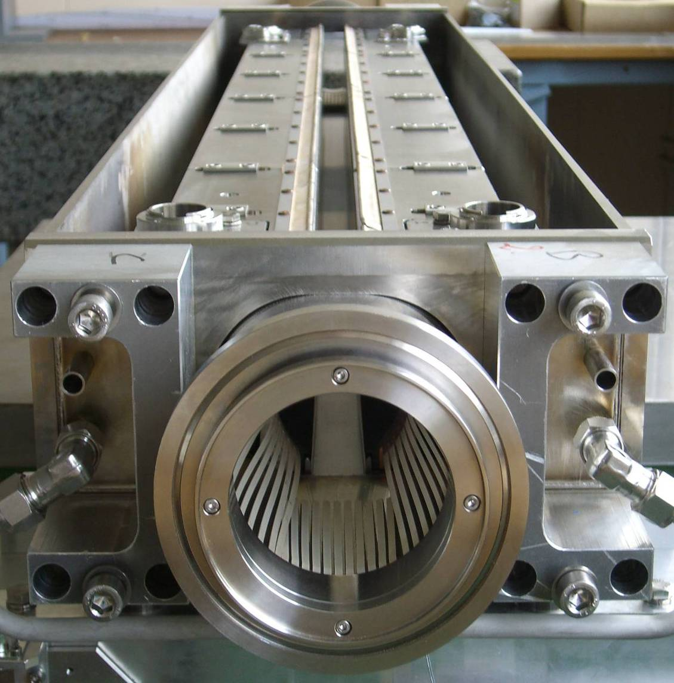

Beam collimation
The complex LHC collimation system worked perfectly – also thanks to excellent beam stabilization.
One full system alignment per machine configuration / year – beyond our wildest dreams !
Almost 100 collimators and absorbers, with a typical length of ~1 m.
The system managed to intercept ~99.99% of the protons that were lost from the beam.
  No magnet was quenched with beam at 3.5 / 4 TeV (unintentionally).
1.2 m
Opening
140 MJ in each beam
versus
few mJ to quench a magnet
beam

Slide 31
Collimator Beam Loss Cleaning Efficiency

Slide 32


Not without risk
Effect of direct beam impact on a Tungsten collimator
Not even collimators are safe !
We are looking for new materials
(experiment at SPS)
1 bunch @ 7TeV
~120 kJ
Onset of damage
~40 kJ
3 bunches @ 7TeV
~360 kJ
Courtesy A. Bertarelli (EN)

Slide 33
Electron cloud
In high intensity accelerators with positively charged beams and closely spaced bunches electrons liberated from vacuum chamber surface can multiply and build up a cloud of electrons.
Bunch N+1 accelerates the e-,
multiplication at impact
Bunch N+2 accelerates the e-,
more multiplication…
Bunch N liberates an e-
e-
e-
++++++
++++++
++++++
N+1
N+2
N
e-
A key parameter is the secondary emission yield of electrons.
The cloud causes increased heat load on cryogenic system, vacuum pressure increases and beam instabilities!
  Electron energies are in the 10- few 100 eV range.

Slide 34


Electron cloud instability
Electron cloud instability causes strong degradation of beam quality.
Bunches at the end of the bunch trains suffer from emittance blow-up.
Fill of trains with 72 bunches
Fill of trains with 288 bunches
Measurements at 25 ns tests end of 2012 run.

Slide 35
Electron cloud mitigation
Strong reduction of e-clouds with larger bunch spacing:
With 50 ns spacing e-clouds are much weaker than with 25 ns !
→ One of the main reason to operate so far with 50 ns.
The e-cloud can ‘cure itself’: the impact of the electrons cleans the surface (Carbon migration), reduces the electron emission probability and eventually the cloud disappears.
‘Beam scrubbing’ consists in producing e-clouds deliberately with the beams in order to reduce the SEY until the cloud ‘disappears’.
  Done at 450 GeV where fresh beams can be injected easily.
In April 2011 50 ns beams were used to ‘scrub’ the vacuum chamber at 450 GeV to prepare operation at 3.5 TeV.
  Further slow improvement during operation at 3.5 TeV and 4 TeV.
  Operation with nominal 25 ns spacing will require further scrubbing.

Slide 36
Flexible beams
We made full use of the flexibility of the LHC and of its injector chain.
Beams with 50 ns bunch spacing are used operationally since April 2011 instead of the design 25 ns spacing.
  More luminosity potential for 50 ns beams.
  Smaller beam emittance (→ size) eases operation..
And it will come even better in 2015.
LHC beam parameters (LHC injection)
Spacing | N (p/bunch) | ε [μm] | Relative luminosity / Bunch Crossing
50 ns | 1.65 x 10¹¹ | 1.8 | 4
25 ns design | 1.15 x 10¹¹ | 3.5 | 1
25 ns BCMS* | 1.2 x 10¹¹ | 1.4 | 2.7
2012
The ‘Dream Beam’ for 2015 / 7 TeV
*BCMS = Batch Compression, (bunch) Merging and (bunch) Splitting in PS

Slide 37


Luminosity Boost from Aperture
Focusing (β*) at the collision point is limited by the aperture of the last focusing quadrupoles (‘triplet’) ⇔ phase space conservation.
triplet
triplet
IP
X
X
X
p_{X}
p_{X}
p_{X}
2012: β* = 0.6 m, design: β* = 0.55 m
This excellent performance was made possible by better than anticipated alignment and control of the trajectories.

Slide 38

Z→ μμ event from 2012 data with 25 reconstructed vertices
Z→ μμ
The price of the high luminosity with fewer collisions: for each bunch crossing there are up to ~35 interactions.
‘Hats off’ to ALTAS & CMS for handling this pile-up !!
2012: ~30 events/xing
at beginning of fill
with tails up to ~ 40.

Slide 39


Surprising ‘Unidentified Falling Objects’
Very fast and localized beam losses were observed as soon as the LHC intensity was increased in 2010.
The origin of those beam losses was traced to dust particles falling into the beam – nicknamed ‘UFO’.
  What triggers the dust to detach from the vac. chamber surface?
If the losses are too high, the beams are dumped to avoid a SC magnet quench.
  Each year 15-20 beams are dumped by such events.
  Fortunately the vast majority of dust particles are too small to cause a problem … so far!
Δt ~ 1 ms
In one specific accelerator component the dust could identified as Aluminum oxide.
100µm
10µm
Could become a more serious issue at 7 TeV !

Slide 40
Outline
Introduction
LHC magnets and early commissioning
LHC performance 2010-2012
Mastering the challenges
Towards top energy

Slide 41
LHC energy evolution
Energy (TeV)
7 TeV
Design
Consolidation of all interconnections
≥ 6.5 TeV
5 TeV
Magnet de-training after installation
4 TeV
Operation
Joint problems,
incident
3.5 TeV
3.5 TeV
Operation
Long Shutdown 1 (LS1)
Consolidation delays
1.18 TeV
2007
2008
2009
2010
2011
2012
2013
2014
2015

Slide 42


Preparing for nominal energy
Around 10’000 high current magnet interconnections will be checked, re-done if needed. All of them will consolidated – 12 months of work.
  No more S34 incident in the future.

Slide 43

Preparing for nominal luminosity
Radiation to Electronics (R2E)
‘On the fly’ equipment relocations and upgrades
2011
~12 dumps per fb⁻¹
2011-2012:
- more relocation.
- additional shielding,
- equipment upgrades
~3 dumps per fb⁻¹
2012
< 0.5 dump per fb⁻¹
Aim for >LS1
equipment relocation,
additional shielding,
critical system upgrades.
Courtesy G. Spezia
Notes:
Extract latest PM-DB plot

Slide 44


The next objective
Turn this planning…
2013
2014
2015
…into beam in 2015

Slide 45
Post LS1 Energy
Our best estimates to train the LHC (with large errors)
  ∼ 30 quenches to reach 6.25 TeV
  ∼ 100 quenches to reach 6.5 TeV
Two quenches/day → 2 to 5 days of training per sector
The plan
  Try to reach 6.5 TeV in four sectors in March 2014
  Based on that experience, we decide for 6.5 TeV or step back to 6.25 TeV

Slide 46
Luminosity projections
Some out of many possible scenarios @ 6.5 TeV
 | Number of bunches | Bunch intensity LHC FT[1e11] | Emit LHC [μm] | Peak Lumi [10³⁴ cm-²s⁻¹] | ~Pile-up | Int. Lumi per year [fb⁻¹]
25 ns | 2760 | 1.15 | 3.75 | 0.93 | 25 | ~24
25 ns BCMS | 2520 | 1.15 | 1.9 | 1.7 | 52 | ~45
50 ns | 1380 | 1.6 | 2.5 | 1.6 level to 0.8 | 87 level to 44 | ~40*
50 ns BCMS | 1260 | 1.6 | 1.6 | 2.3 level to 0.8 | 138 level to 44 | ~40*
Many scenarios imply luminosity levelling to control pile-up
  Discussion & optimization between machine & experiments.
(*) leveled down to a pile-up of ~44.
Int. L based on 150 days of production/year, 35% efficiency.

Slide 47

Leveling luminosities
In run 1 we have leveled the luminosity of LHCb by adjusting the offsets between the beams.
In run 2 we are considering to level luminosities by adjusting β* (beam size at IP).
  Better / mandatory for beam stability.
Luminosity
7x10³³ cm⁻²s⁻¹
ATLAS/CMS
Fill 3330 / 2012
LHCb – leveled by offset
Time

Slide 48
50 ns versus 25 ns
 | 50 ns | 25 ns
GOOD | Lower total beam current Higher bunch intensity Smaller emittance | Lower pile-up
BAD | High pile-up Need to level Pile-up stays high High bunch intensity – instabilities… | More long range collisions: larger crossing angle; higher β* Larger emittance Electron cloud: need for scrubbing; emittance blow-up; Higher UFO rate Higher injected bunch train intensity Higher total beam current
Expect to move to 25 ns because of pile-up….

Slide 49
Most likely LHC operation script for 2015
During magnet re-commissioning in 2014 we will define the target energy for the run : ≥ 6.5 TeV.
Early in 2015 we will explore the LHC at 6.5+ TeV with low intensity.
  Full system commissioning up to first collisions ~ 2 months.
The first serious luminosity and some intensity ramp up will be made with 50 ns spacing.
  We think that we know how to do that!
This will be followed by preparation of the LHC for 25 ns operation – electron cloud reduction at injection – 2 weeks.
…and finally intensity ramp up and production at 25 ns.

Slide 50
The nominal energy era
But there are new challenges waiting for us out there.
  The magnets will be running close to their limits,
  The tolerable beam loss will be reduced by a factor ~10-20,
  The machine availability may suffer from UFOs,
  We may encounter limitations on the total intensity,
  Electron clouds with 25 ns spacing bunches,
  And the things that we have not anticipated…

Slide 51

UFO frequency and future issues
Rate (/hour)
Steady decrease of the UFO rate with time from ~10 / hour to less than 2 hour, but…
time
At 7 TeV:
The energy deposition in the magnets will increase by a factor 2-3,
The tolerable loss will go down by a factor 4-5 (quench margin smaller),
→ at 7 TeV UFOs could cause one beam loss / dump per DAY !! Could become a serious issue !!

Slide 52
25 ns & electron cloud
The Secondary electron Emission Yield evolution significantly slowed down during the last scrubbing fills (more than expected by estimates from lab. measurements and simulations)
  Reconstructed comparing heat load meas. and PyECLOUD sims.
Giovanni Iadarola and team - Evian 12
Change of mode of operation with 25 ns. Electron cloud free environment after scrubbing at 450 GeV not be reachable in acceptable time.
Operation with high heat load and electron cloud density (with blow-up) seems to be unavoidable with a corresponding slow intensity ramp-up.

Slide 53

The next few years
LS1
Physics at ≥ 6.5 TeV
Deliver 300 fb⁻¹ at ≥ 6.5 TeV
LS2
“Ultimate” Physics
LS3
HL-LHC

Slide 54

Conclusion
  LHC Run 1 has come to an end
  The start was difficult and forced us to rethink our strategy to be better prepared – S34 incident.
  Result: LHC run 1 performance was beyond every expectation: 28 fb⁻¹ for ATLAS and CMS ➔ Higgs boson
  Interesting and challenging times ahead after Long Shutdown 1
    Operation at ~ nominal energy, bunch spacing, total current
  Our legacy for post Long Shutdown 1:
    Excellent hardware, integration, tools and teams
    Huge amount of experience & understanding gained
The LHC Operations Crew

Slide 55
EXTRA slides

Slide 56



The LHC run1 timeline – the end
December 2011
5.6 fb⁻¹
4 TeV
March 2012
4 TeV
June 28, 2011
1380 bunches
February 21, 2013
Long shutdown 1
1380
2009
2010
2011
2012
2013
November 2010
First Lead ion run
July 4, 2012
Higgs Seminar
January 2013
Protons & Lead
March 30, 2010
First collisions at 7 TeV CM

Slide 57

The LHC Injector Chain

Slide 58



Cryogenics
Most of the LHC magnets are cooled with superfluid He at 1.9K.
  Very low viscosity.
  Very high thermal conductivity.
In 2012 the availability of the cryogenics reached ~95%!
  Availability ~97% if external failures are excluded !!
24 km & 20 kW @ 1.8 K
36’000 t @ 1.9K
130 t He inventory
(distribution line)
(interconnection box)

